Slide 1
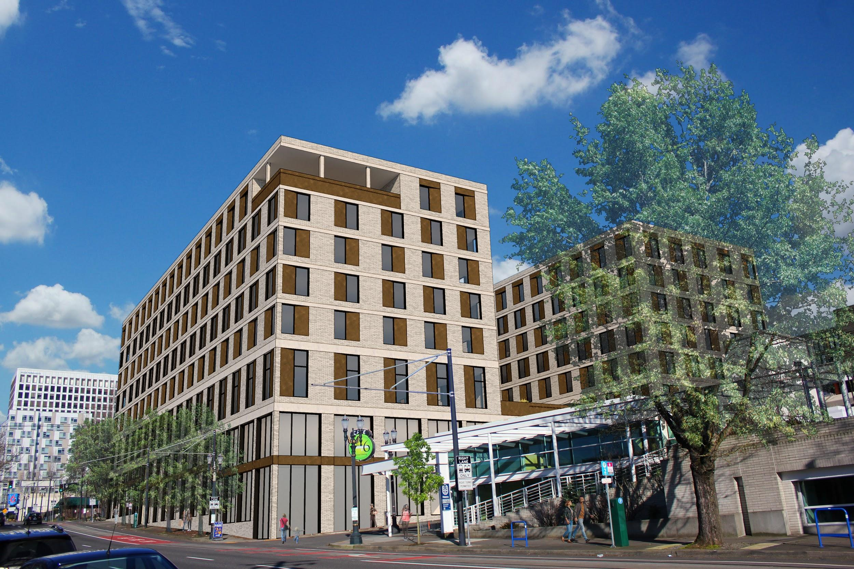
LAND ROVER BLOCKS DEVELOPMENT
ZENITH DEVELOPMENT GROUP | PSU MRED WORKSHOP WINTER 2021

Slide 2
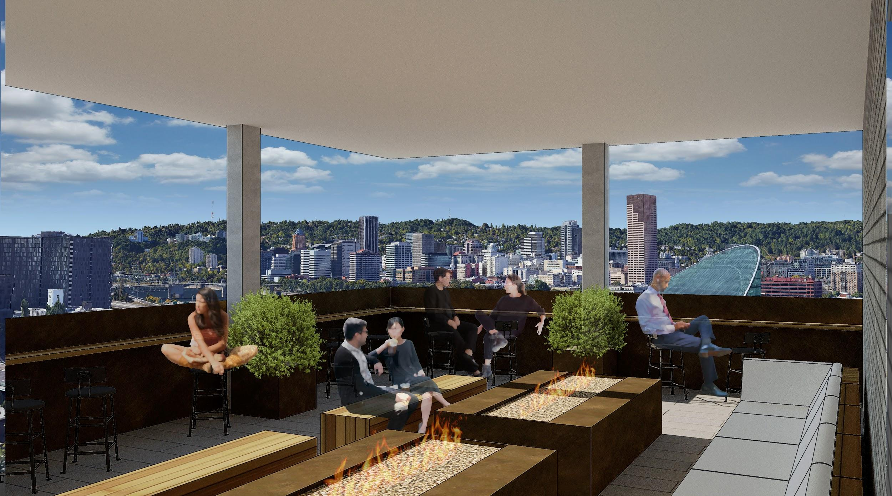
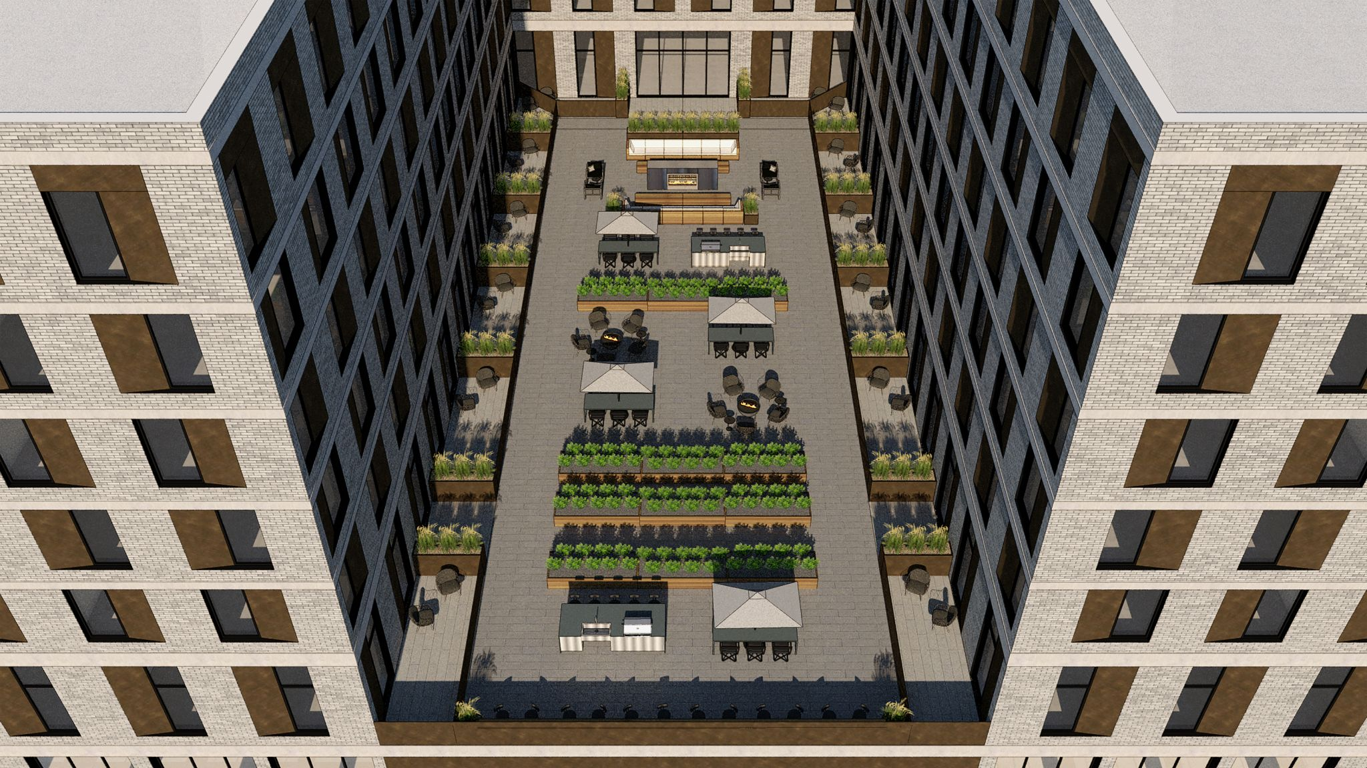
EXECUTIVE SUMMARY
TOTAL DEVELOPMENT COST
La Pluie $91,923,560
Roots $52,216,933
STABILIZED DATE
La Pluie 12/1/25
Roots 4/1/25
TOTAL # OF UNITS
La Pluie 256 ((20) 1-bd & (5) 2-bd IZ units)
Roots 129 (All affordable and IZ)
KEY METRICS
La Pluie 12.09% Leveraged IRR
2.88x Equity Multiple
$5.563M Leveraged NPV
Roots $919,256 Stabilized NOI
1.32 Stabilized DSCR
$5,500,000 Developer Fee
$17,753,413 - LIHTC LP Proceeds
Notes:
This Zenith Development project will consist of market rate and affordable housing with a unique blend of retail tenants. La Pluie and Roots will provide a platform and a place for our tenants, the Lloyd District workers, and Oregon Convention Center attendees to have a central place for its community members to gather, eat, drink, and interact.
The construction of the Blumenauer Bridge will improve accessibility for residents of the eastside neighborhoods to the south of I-84, while our food hall, daycare, and cafe will provide much needed amenities and a place for community members to live, work, and play.

Slide 3
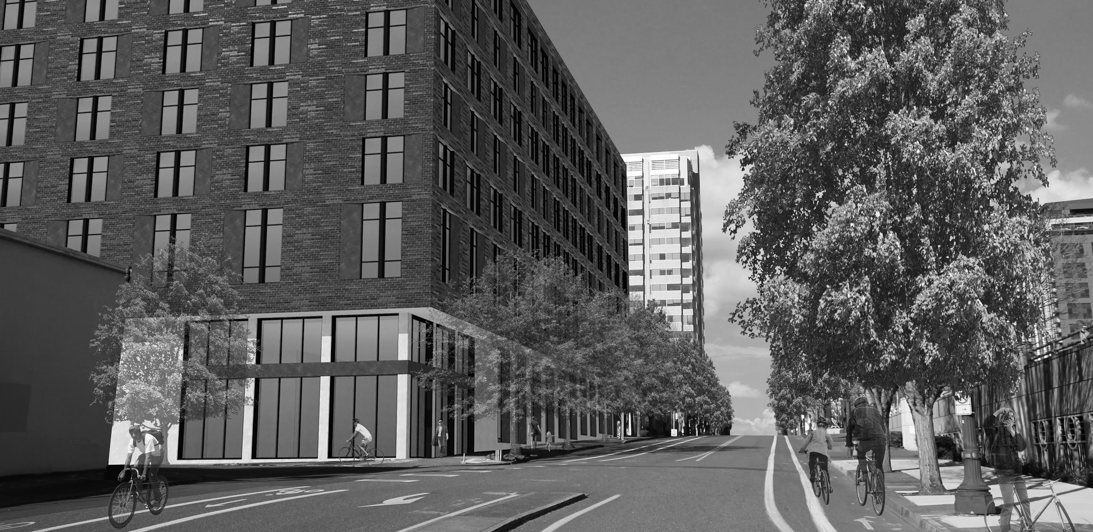
SITE AND PLANNING CONTEXT

Slide 4
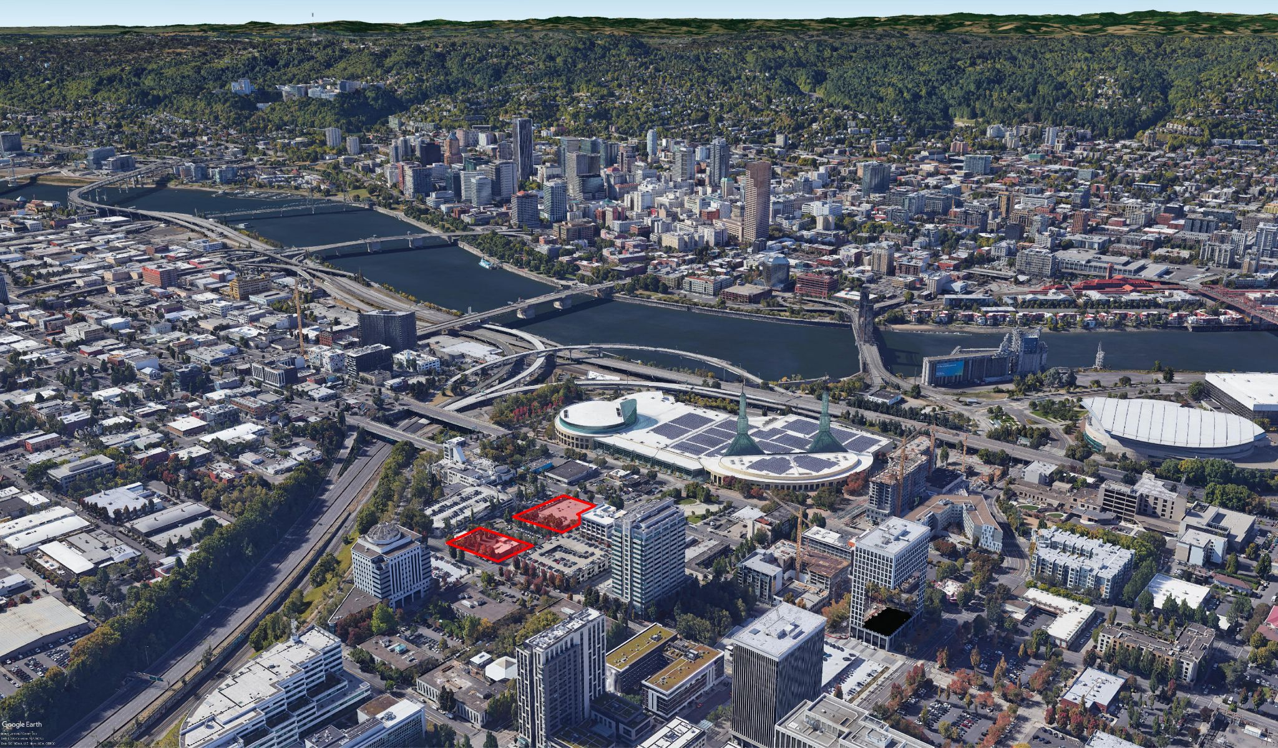

Slide 5
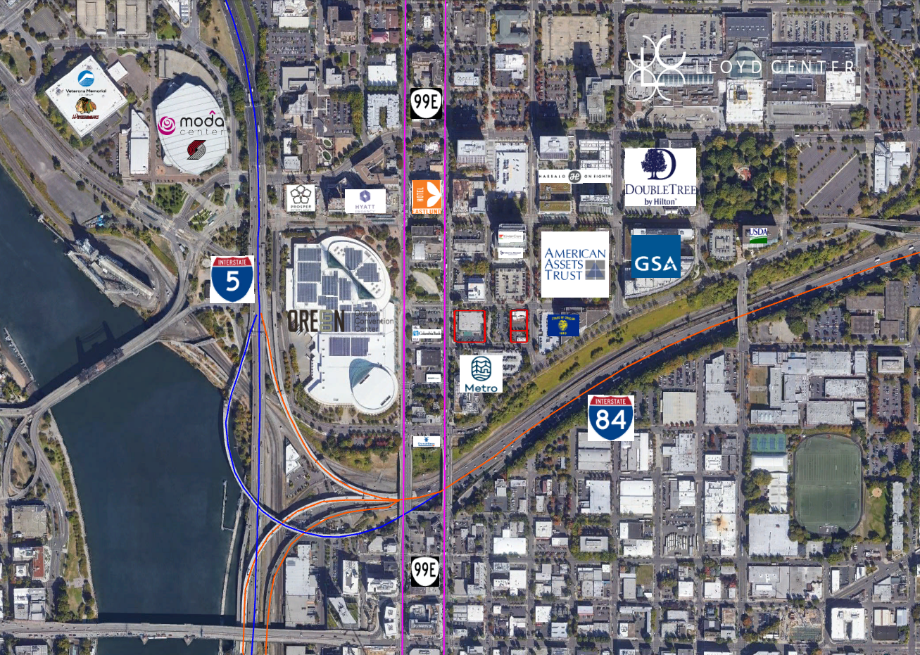

Slide 6
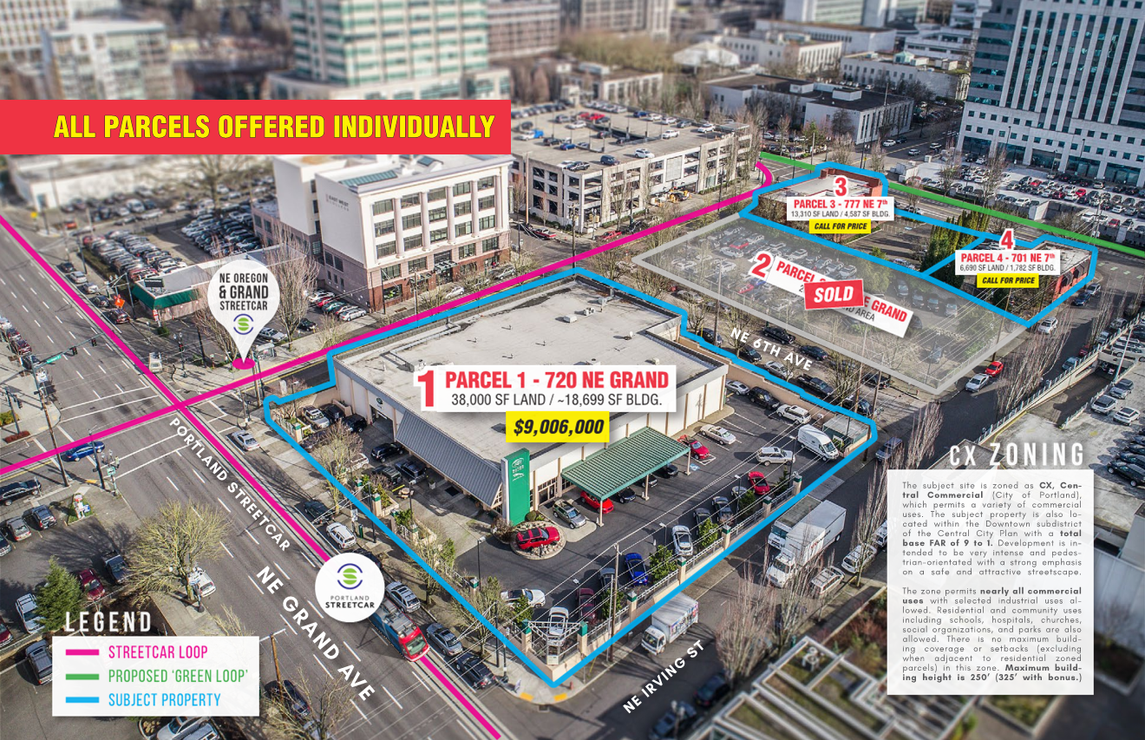
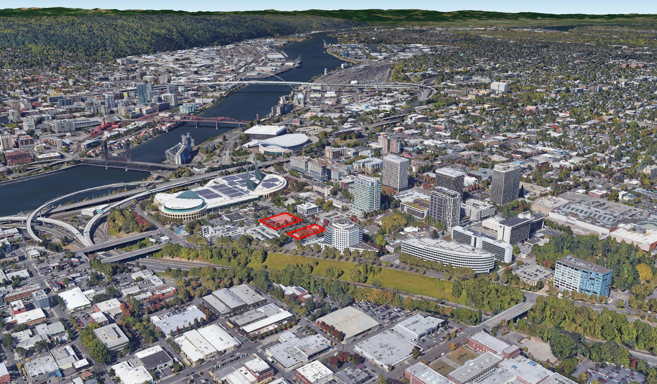

Slide 7
UNIT TYPE | QUANTITY | AVERAGE NET SF | TOTAL SF
Live/Work | 7 | 994 | 6,958
Studio | 94 | 437 | 41,078
1-BR | 120(30 IZ) | 620 | 74,400
2-BR | 35 | 1,016 | 35,560
Total | 256 |  | 157,996
ZONING AND PLANNING CONTEXT
Base Zoning | CX (Central Commercial)
Overlay Zoning | d (design)
Plan District | CC - Central City Plan District - Lloyd
Base FAR | 4:1 or 9:1 if all floors above the ground floor are residential use
Max. FAR w/ Bonus | 6:1 or 12:1 with Inclusionary Housing, up to 12:1 with Affordable Housing Fund Contribution
Max. Height | 250’, 325’ w/ Bonus
Min. Building Setbacks | None, 5’ at Ground Floor Dwelling Units
Max. Building Setbacks | 10’
Parking Area | Area 2 in Central City Plan
Parking Min. | None required per transit adjacency
Parking Max. | Residential 1.2:1 (Stall/Unit)
 | Retail Sales - 1.35:1 (Stall/1,000 SF net building area)
 | Daycare - 1.35:1 (Stall/1,000 SF net building area)
 | Community Service - 0.5:1 (Stall/1,000 SF net building area)
Active Use Requirements | Ground level dwelling units are prohibited along NE Grand
 | Ground Floor Window Standard to be met along atleast 50% of ground floor walls along ROW
 | Min. 12’ high space from finished floor to ceiling or bottom of structure along NE Grand
Residential Outdoor Area | Yes, 48 SF per unit through individual space or shared area
 | (can be mix of outdoor and indoor areas with specific area requirements)
EcoRoof Standard | New building with a net building area of 20,000 SF or more must have an EcoRoof
UNIT TYPE | QUANTITY | AVERAGE NET SF | TOTAL SF
Studio | 41 | 421 | 17,261
1-BR | 18 | 608 | 10,944
2-BR | 58 | 865 | 50,170
3-BR | 12 | 1,025 | 12,300
Total | 129 |  | 90,675
BUILDING HEIGHT
NE 7TH & NE IRVING - 92’
NE 7TH & NE OREGON - 84’
CONSTRUCTION TYPES
LEVELS 1-2 | TYPE IA CONSTRUCTION
LEVELS 3-7 | TYPE IIIA CONSTRUCTION
Notes:
Looking at the zoning of these sites, they are both Central Commercial and design review is required. CX zoning allows for intense development and is flexible in terms of potential uses, but the Central City Plan District specifically incentivizes dense residential development over ground floor commercial uses. This approach allows for a base FAR of 9 to 1 and a bonus FAR of 12 to 1. Parking is not required for these sites based on transit adjacency, and there are parking maximums set by the plan district.

Slide 8
MARKET ANALYSIS

Slide 9
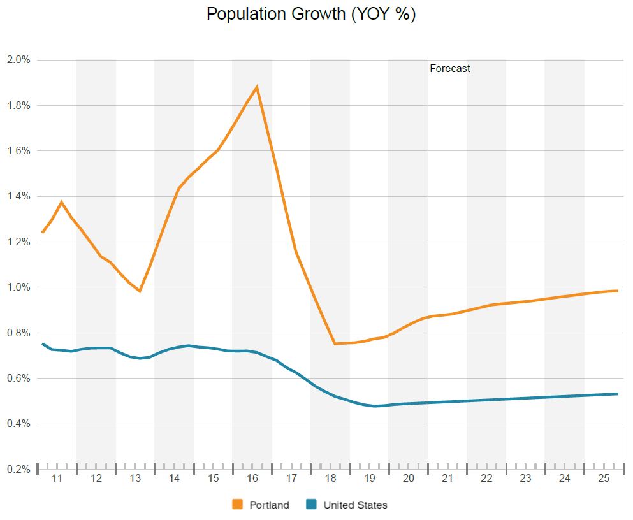
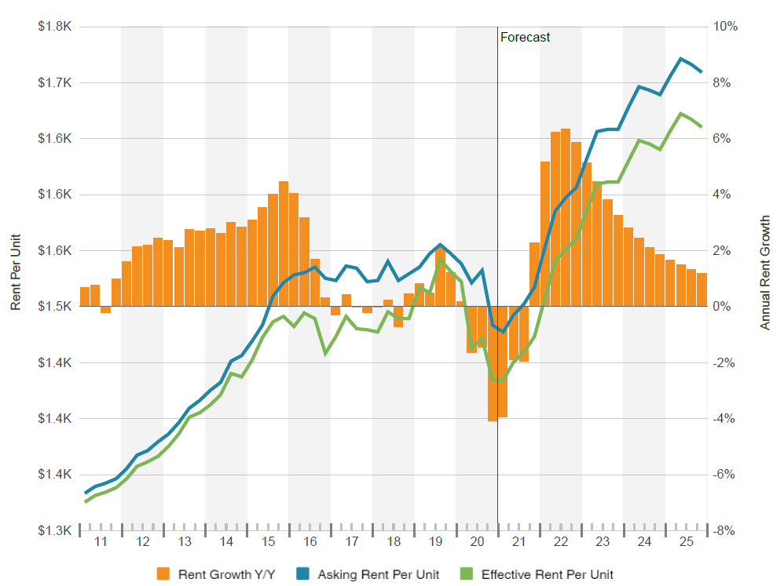
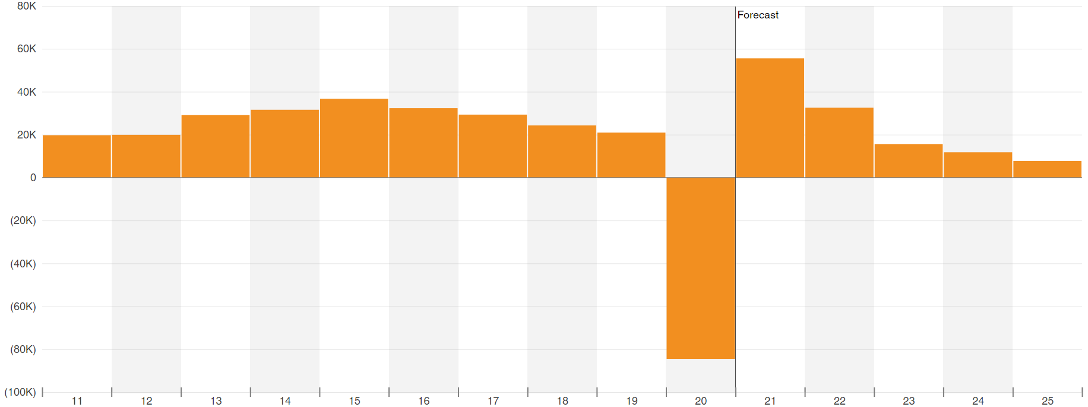
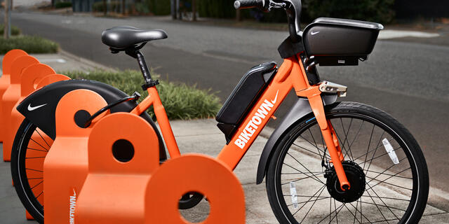
LLOYD DISTRICT MARKET ANALYSIS
Population Growth:
Rent Growth
Economy
Parking:
Net Employment Change
Notes:
For the population growth, only 19% of the population growth was natural increase (e.g. births) while the rest can be attributed to migration.
The median age in Portland is 37.1 years and for Portland -Vancouver-Hillsboro, OR-WA MSA is slightly less than the median age for all of Oregon and the rest of the United States.
The unemployment rate in May was almost 15%. However, due to Portland's dynamic economy, it is well placed to tackle the crisis than many other metropolitan areas.
Looking at the graph on the top right, Rent growth for the Lloyd District in 2020 was hit hard due to the pandemic. Add to this the flood of deliveries in recent years as well as local protests, rent growth experienced a 7% decline in asking rent. Looking forward to 2021 with the prospect of mass vaccinations and civil unrest settling down, rents are anticipated to bounce back remarkably with a growth rate slightly under 6% until 2023.
1- bedapts in portland has the lowest vacancy rates, meaning our project not only financially pencil, but the majority of units we have are 1-bed
On the Parking aspect La Pluie and Roots exceptional location is leveraged by constructing less parking spaces than the comps since it is situated adjacent to the PDX Streetcar running along NE Grand Ave and NE Oregon St.
The project provides an opportunity for more than 16,000 sf of retail space in total. Along Grand we are proposing two retail tenant spaces the space to the southwest will be a food hall, space to the northwest will be a childcare center while the space on oregon st and 6th st will be attractive for a café user.

Slide 10
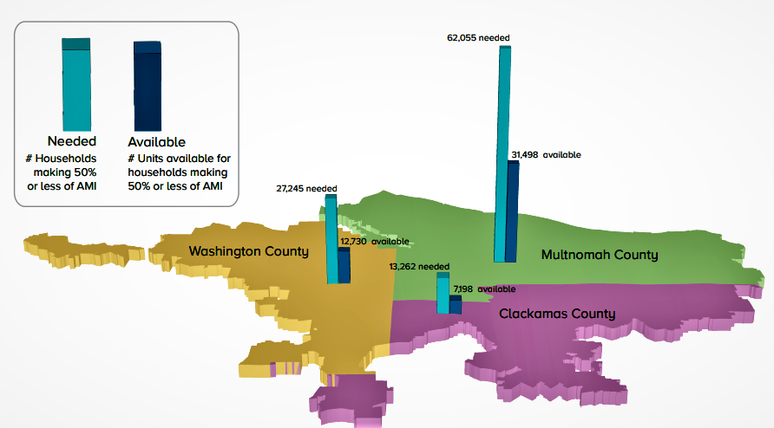
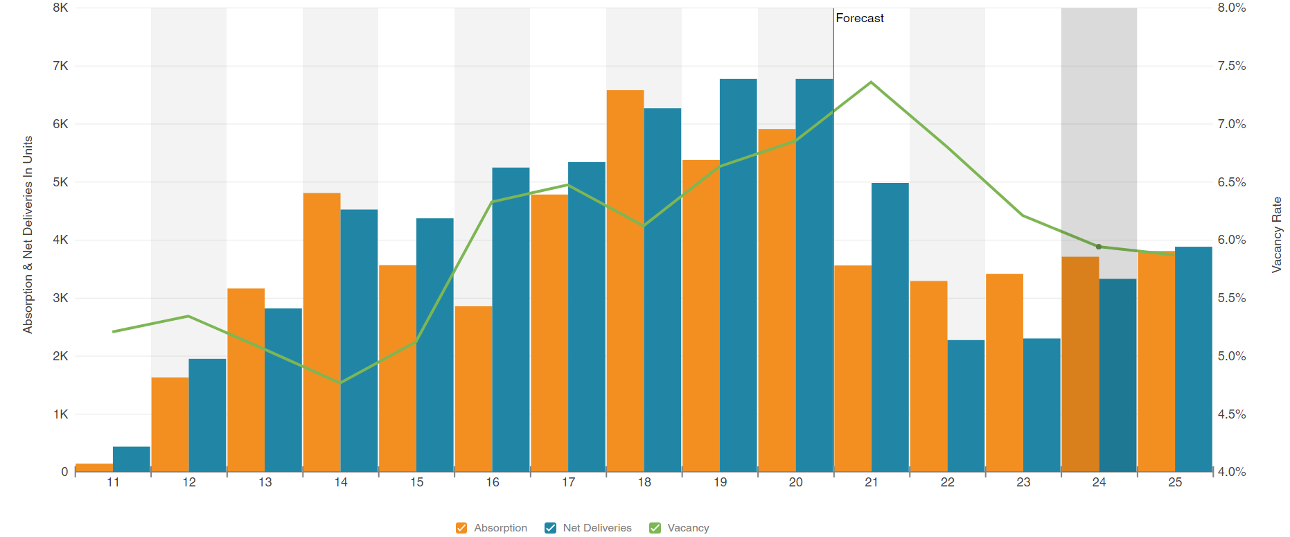
SUPPLY ANALYSIS
Market Rate:
rent growth in the region between 2014-2016
Portland City Council’s passing of Inclusionary Zoning
Affordable:
According to the most recent statistics in Portland, Oregon, there are 304 low-income housing communities with 20,092 affordable rentals.
Rent growth decreased at a period when the median income was rising by 8% to 9% annually, this has culminated in availability of housing today, and is accessible for a 90% of MFI.
Source: Metro
Notes:
In the early six months of 2020, approximately 3200 apartments were delivered. Although the pandemic is affecting building pipelines, additional 6,400 units are currently under development.
The diagram on the right shows Demand versus supply of affordable homes to families with a median income of 50 percent or less (AMI).
In all three counties of the Portland metro there is a lack of affordable housing in relation to demand. The city of Portland has described the need that at least 23000 more homes need to be supplied to low and moderate-income families.

Slide 11
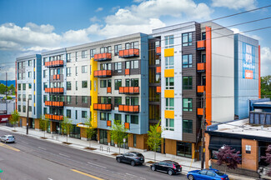
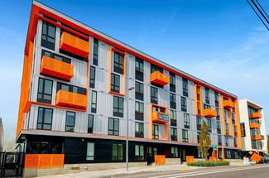
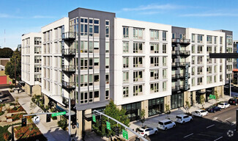
Market Rate Comps
Sandy 28 (2869 NE Sandy Blvd)
2020
209 Units
Cadence (2005 N Williams Ave )
2018
166 Units
Broadstone Anthem (1313 E Burnside St)
2020
211 units
Notes:
This map shows the nine market rate comps to La Pluie project. The nearest 2 comps, Broadstone Anthem and Cadence are 1 mile distant, and the furthest comp, Sandy 28 is 2.5 miles away.

Slide 12
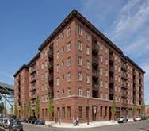
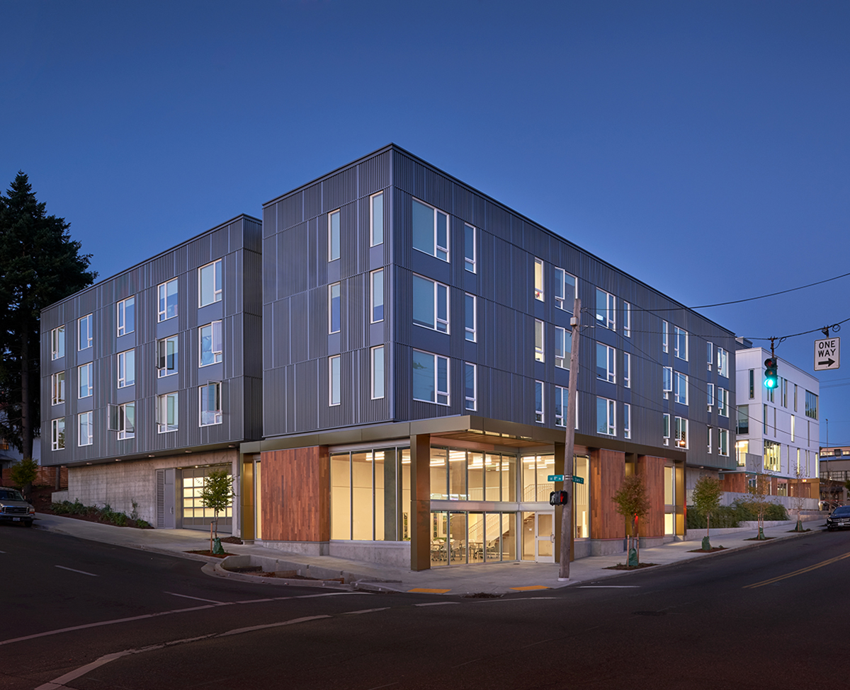
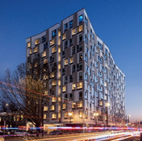
Affordable Comps:
The Ramona(1550 NW 14th Ave) Apartments
Year Built: 2017
138 Units
Saint Francis Park Apartments(1177 SE Stark S)
Year Built: 2017
106 Units
Louisa Flowers(1010 NE Grand)
Year Built: 2019
240 Units
Notes:
The three main rent comps to Roots project are displayed on the map. Louisa Flowers is the nearest comp with 240 units and only .02 mi away, followed by St. Francis Park apartments with 138 affordable units and 1.1 mi distant. While the last rent comp is The Ramona apartments with 106 units and 2.1 miles out.

Slide 13
DEVELOPMENT PROPOSAL

Slide 14
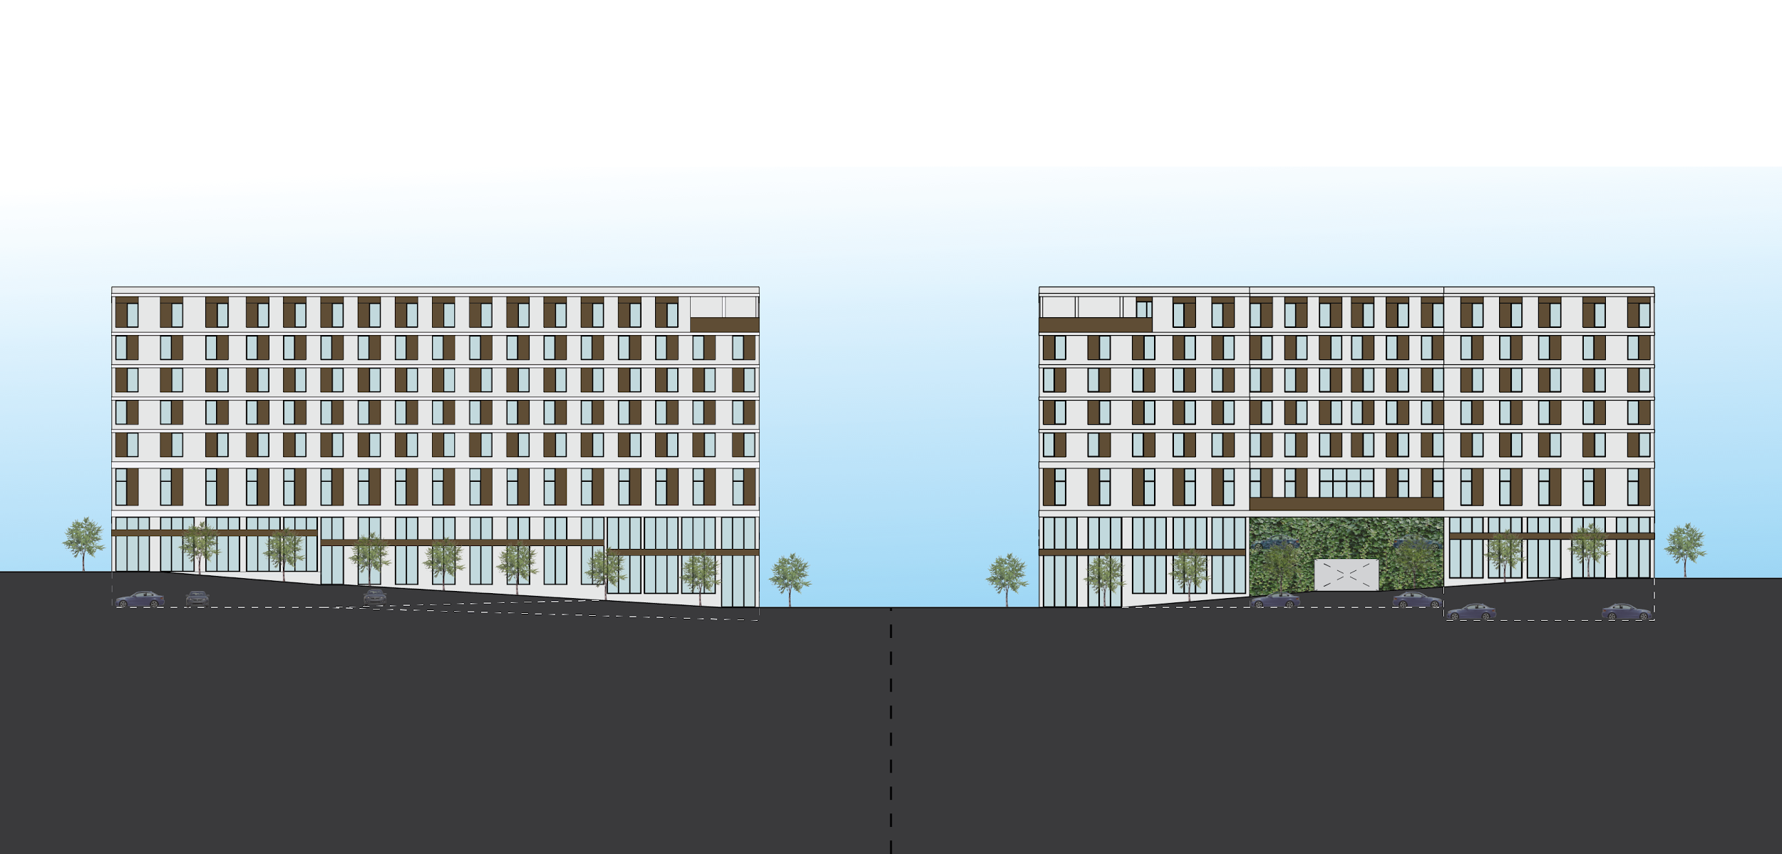
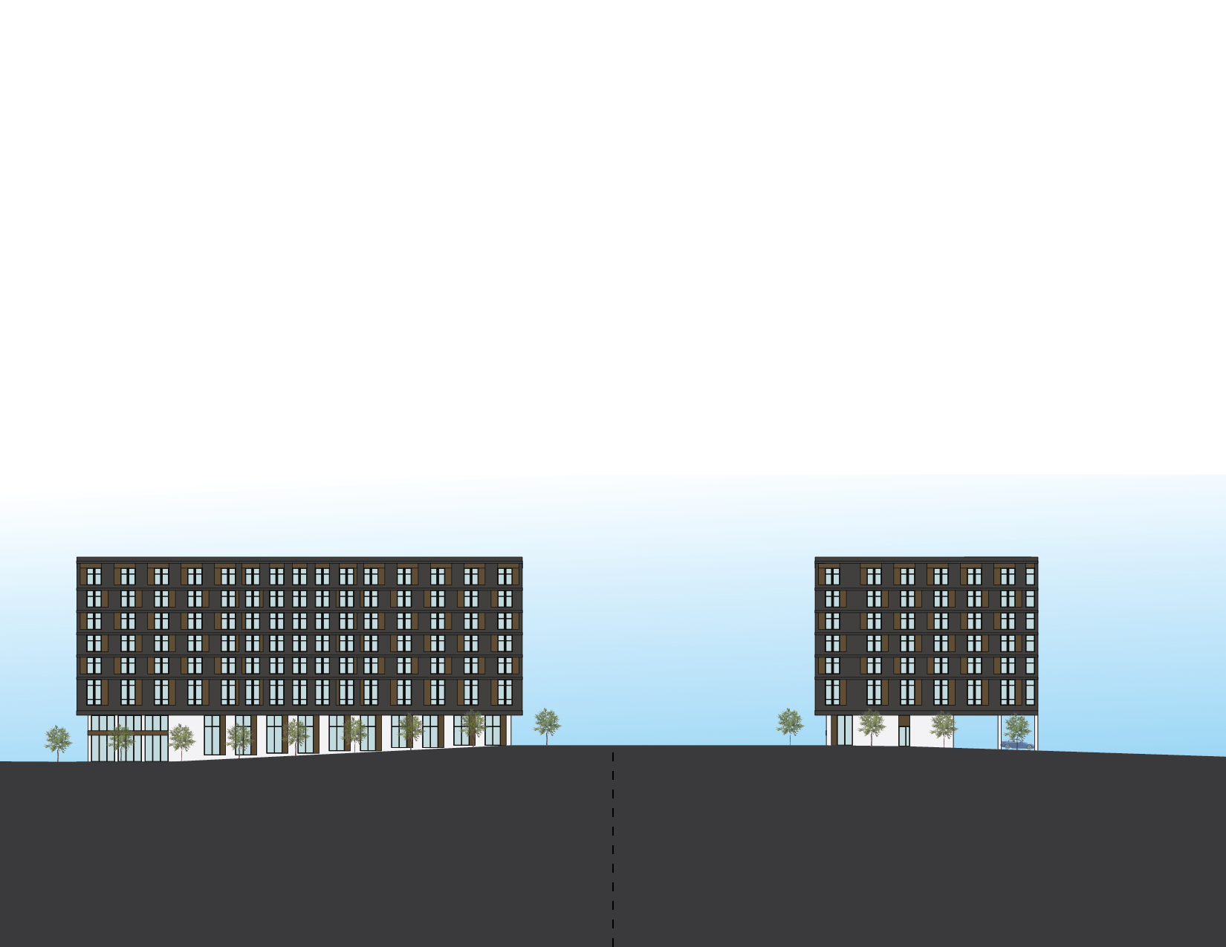
EAST ELEVATION - NE IRVING
COMPARING CONSIDERATIONS
LA PLUIE - MARKET RATE
WEST ELEVATION - NE GRAND
Unit Mix | Percent | Quantity | Average Net SF | TotalSF
Live/Work | 2.7% | 7 | 994 | 6,958
Studio | 36.7% | 94 | 437 | 41,078
1-BR | 46.9% | 120(30 IZ) | 620 | 74,400
2-BR | 13.7% | 35 | 1,016 | 35,560
Total | 100% | 256 |  | 157,996
 | MARKET RATE | AFFORDABLE
Commercial Uses | Increases incomes for development | Prohibited by LIHTC funding - Would require condominiumization
Residential Unit Mix | Follows market trends and can be modified based on development team priorities | 50% 2-Bedroom or more required per PHB funding requirement, larger units fundamentally produce lower rent/sf than smaller units
Residential Amenity Space | Boosts residential lease rates above comparables | Doesn’t contribute to rental rates, but are needed for residented benefit
Unit Sizes | Determined by market needs | Controlled by area ranges per unit type by Oregon Housing and Community Service (OHCS)
Units Rents | Driven by market which is affected by economy, annual unit production, domestic inmigration, etc. | Set annually after taxes, percentage of area median income which is an indicator of the market but skews higher than average. Increase in area incomes outpaces lower income growth meaning affordable housing becomes less affordable in hot markets.
Parking | Income generator with rates demanded higher than required by zoning code | Can’t generate income but demands rates higher than required by zoning code, huge need for family sized units prioritized by City of Portland
15,542 SF of leasable retail space in 4 tenant spaces with entrances at street corners
RETAIL TENANT ENTRANCE
UNDERGROUND PARKING
TOP LEVEL ROOF DECK
ROOTS - AFFORDABLE
EAST ELEVATION - NE 7TH
NORTH ELEVATION - NE OREGON
Unit Mix | Percent | Quantity | Average Net SF | TotalSF
Studio | 31.8% | 41 | 421 | 17,261
1-BR | 14.0% | 18 | 608 | 10,944
2-BR | 45.0% | 58 | 865 | 50,170
3-BR | 9.2% | 12 | 1,025 | 12,300
Total | 100% | 129 |  | 90,675
- Unit mix per PHB Bond 50% 2-BR or greater target
- Unit sizes based on OHCS guidelines
15,542 SF of leasable retail space in 4 tenant spaces with entrances at street corners
MAIN BUILDING ENTRANCE
COMMUNITY SPACE
GROUND LEVEL STUDIO UNITS
LA PLUIE MARKET RATE HOUSING DEVELOPMENT
256 units total
Unit mix is more than 85% studio or 1-BR units
30 1-BR units at 60% AMI IZ units (out of 120)
15,542 SF retail space for 4 tenants with entrances at street corners
Targeting Earth Advantage Multifamily Certification and comparable EUI performance to affordable building
ROOTS AFFORDABLE HOUSING DEVELOPMENT
129 units total
8 units at 30% AMI, 121 units at 60% AMI
Unit mix per PHB Bond 50% 2-BR or greater target
Units sizes are slightly smaller than LA Pluie because unit areas follow Oregon Housing and Community Services (OHCS) Design Guidelines
Targeting Earth Advantage Multifamily Certification, <28 EUI required of PHB Bond funded projects
Notes:
Given these current market conditions and zoning, we are proposing two 5 over 2, podium and wood construction developments on the full block parcel 1 and half block combined parcels 3 and 4. For the full block development, we are proposing this be the site for market rate housing along with ground floor retail. We are then proposing an affordable housing development for the half lock to the east.
While these buildings will both be primarily housing, their drivers and funding sources impact their programs very differently. Market rate is driven by the needs and desires of the market and its use mix, area sizes, and rents are flexible but based on factors of supply, demand, location, etc. The target is maximizing income and sale values.
For the affordable housing program, almost all income generating program is either capped or prohibited by public funding sources and space planning along with furnishings are dictated by prescriptive guidelines. The name of the game for affordable housing is reducing non-residential unit area as much as possible and building to last because expenses are underwritten to increase faster than income, minimizing your margins over time especially in permanently supportive housing.

Slide 15
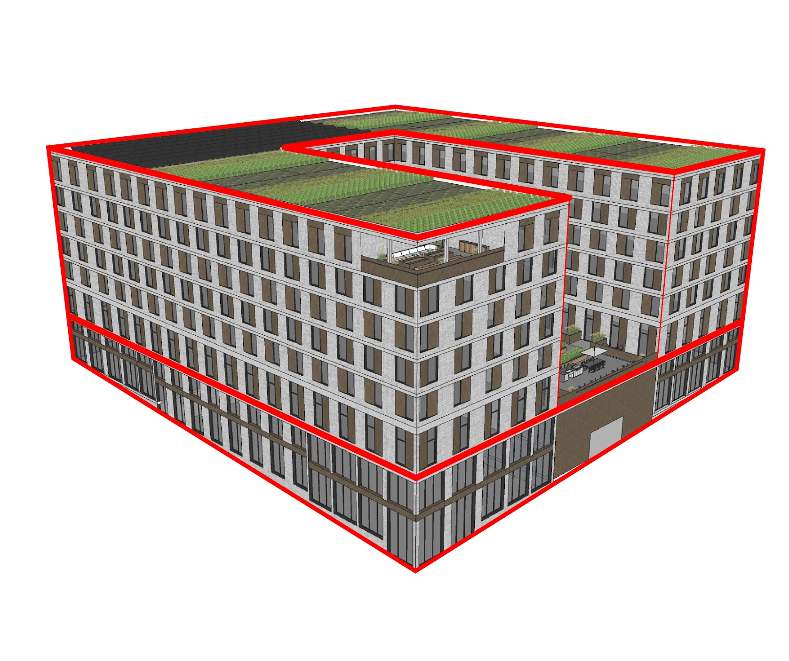
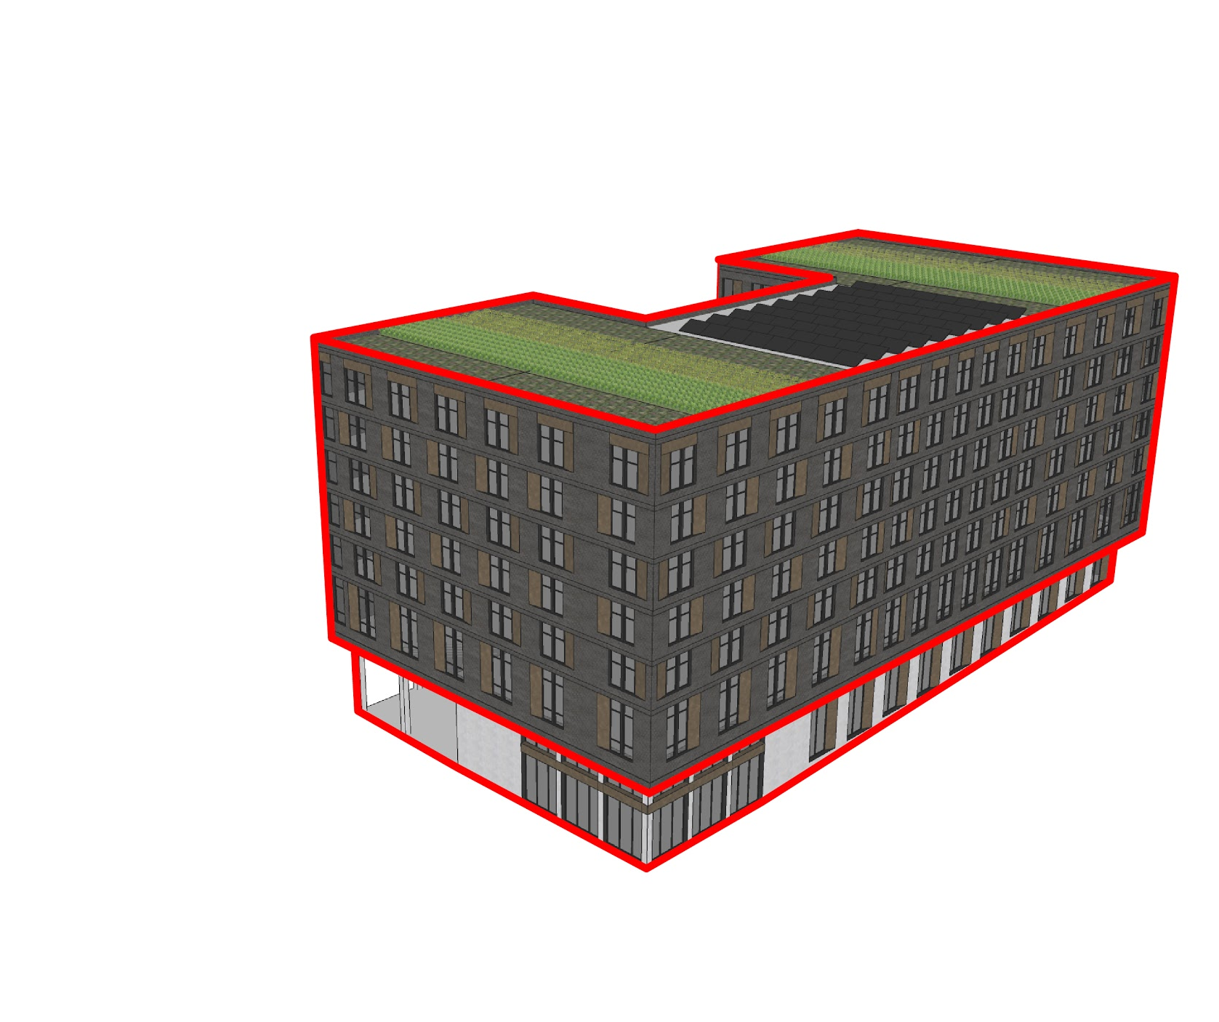
UNIT TYPE | QUANTITY | AVERAGE NET SF | TOTAL SF
Live/Work | 7 | 994 | 6,958
Studio | 94 | 437 | 41,078
1-BR | 120(30 IZ) | 620 | 74,400
2-BR | 35 | 1,016 | 35,560
Total | 256 |  | 157,996
LA PLUIE MARKET RATE HOUSING
ECOROOF
Live/Work | 3%
Studio | 37%
1-BR | 47%
2-BR | 13%
Total Units | 256
GSF | 206,369
Res. Unit Efficiency | 82.80%
Parking Stalls | 122
Res. Parking Ratio | 0.39 : 1
Retail Parking Ratio | +1.46 : 1,000SF leasable area
Parking Type | Underground and structured
Construction Type | 7 Stories, U-Shape 5 over 2
RESIDENTIAL UNITS & AMENITIES
RETAIL, PARKING, RESIDENTIAL UNITS & AMENITIES
BUILDING HEIGHT
NE GRAND & NE IRVING - 99’
NE 6TH & NE OREGON - 80’
NE GRAND AVE.
NE IRVING ST.
ROOTS AFFORDABLE HOUSING
Studio | 32%
1-BR | 14%
2-BR | 45%
3-BR | 9%
Total Units | 129
GSF | 112,422
Res. Unit Efficiency | 80.65%
Parking Stalls | 31
Parking Ratio | 0.24:1
Parking Type | Surface
Construction Type | 7 Stories, C-Shape 5 over 2
UNIT TYPE | QUANTITY | AVERAGE NET SF | TOTAL SF
Studio | 41 | 421 | 17,261
1-BR | 18 | 608 | 10,944
2-BR | 58 | 865 | 50,170
3-BR | 12 | 1,025 | 12,300
Total | 129 |  | 90,675
ECOROOF
RESIDENTIAL UNITS & AMENITIES
SERVICES, PARKING, RESIDENTIAL UNITS & AMENITIES
BUILDING HEIGHT
NE 7TH & NE IRVING - 92’
NE 7TH & NE OREGON - 84’
BUILDING HEIGHT
NE 7TH & NE IRVING - 92’
NE 7TH & NE OREGON - 84’
CONSTRUCTION TYPES
LEVELS 1-2 | TYPE IA CONSTRUCTION
LEVELS 3-7 | TYPE IIIA CONSTRUCTION
NE IRVING ST.
NE 7TH AVE
Notes:
Taking these considerations into account, the market rate unit mix will have 85% 1 bedroom or smaller units because they are not only higher income earning units, but this mix is in line with our market comps, which show 1 bedrooms having the lowest vacancy rates of any current unit type. Alternatively, the Roots affordable development will have more than 50% of the units be 2 bedrooms or larger to meet a PHB bond requirement and was generated in direct response to our city and regional need for family sized affordable units.

Slide 16
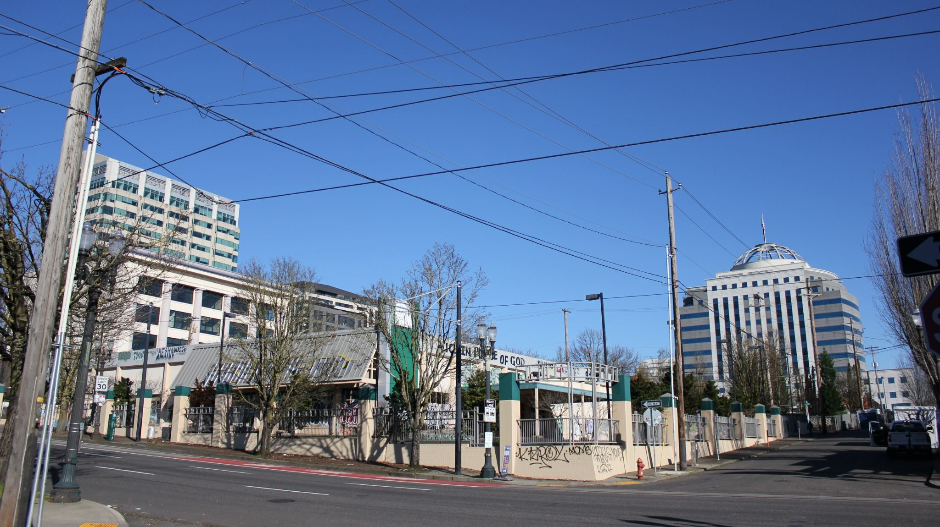
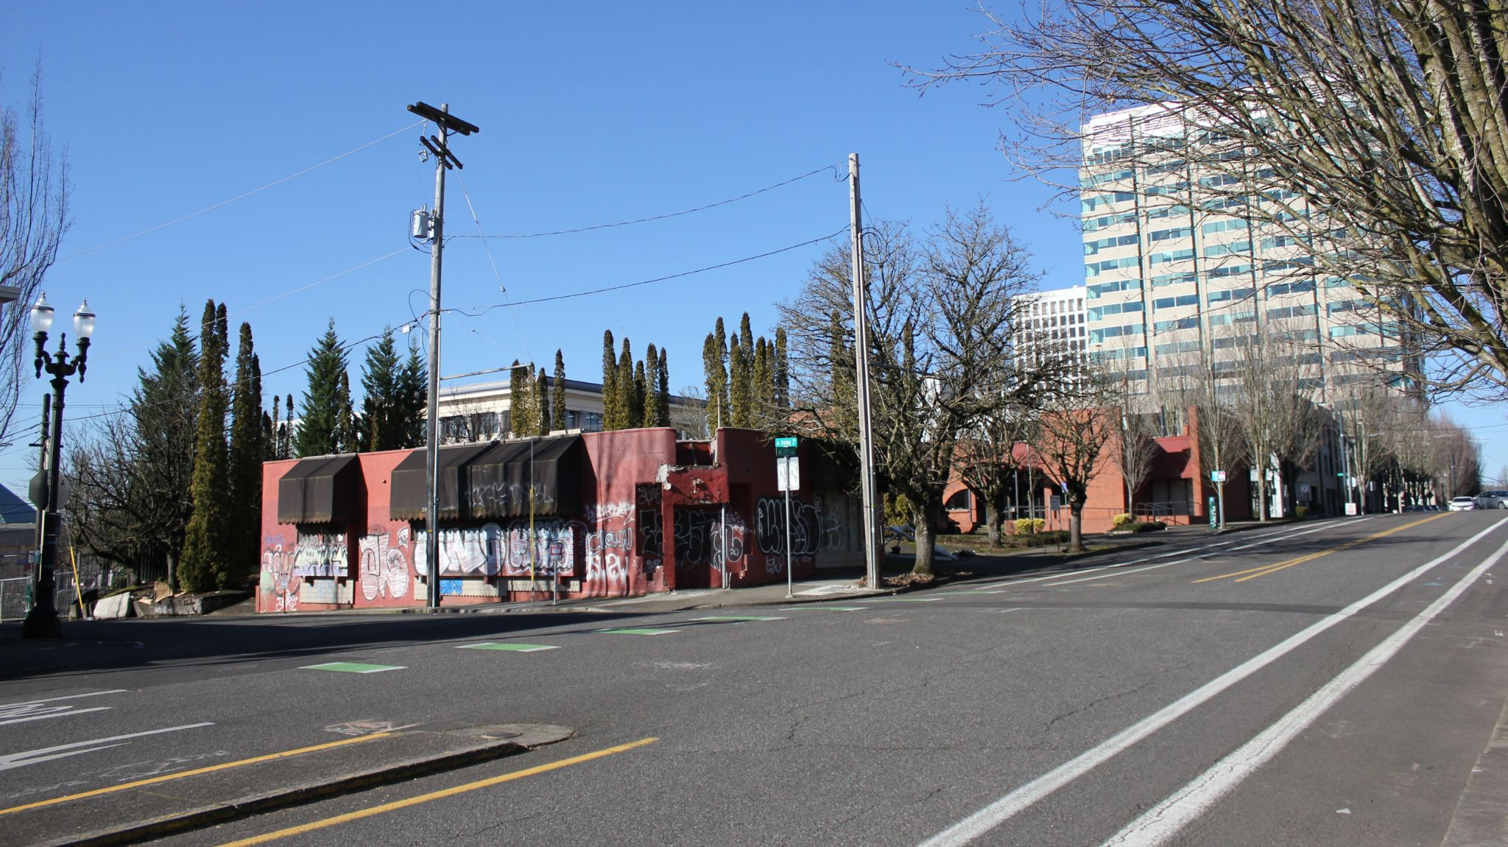
EXISTING SITE CONDITIONS
NE OREGON ST
NE 6TH AVE
NE 7TH AVE
PARKING
ENTRY
12’ GRADE SLOPE
21’ GRADE SLOPE
NE IRVING ST
NE GRAND AVE
PARKING
ENTRY
Notes:
Taking a step back and looking at how these developments will respond to the site, both sites have existing buildings and significant grades sloping from northeast down to southwest with the drop being 2 stories for the market rate site and a single story for the affordable site. These existing conditions could be viewed as obstacles to contend with but for this development they will be design and construction assets.

Slide 17
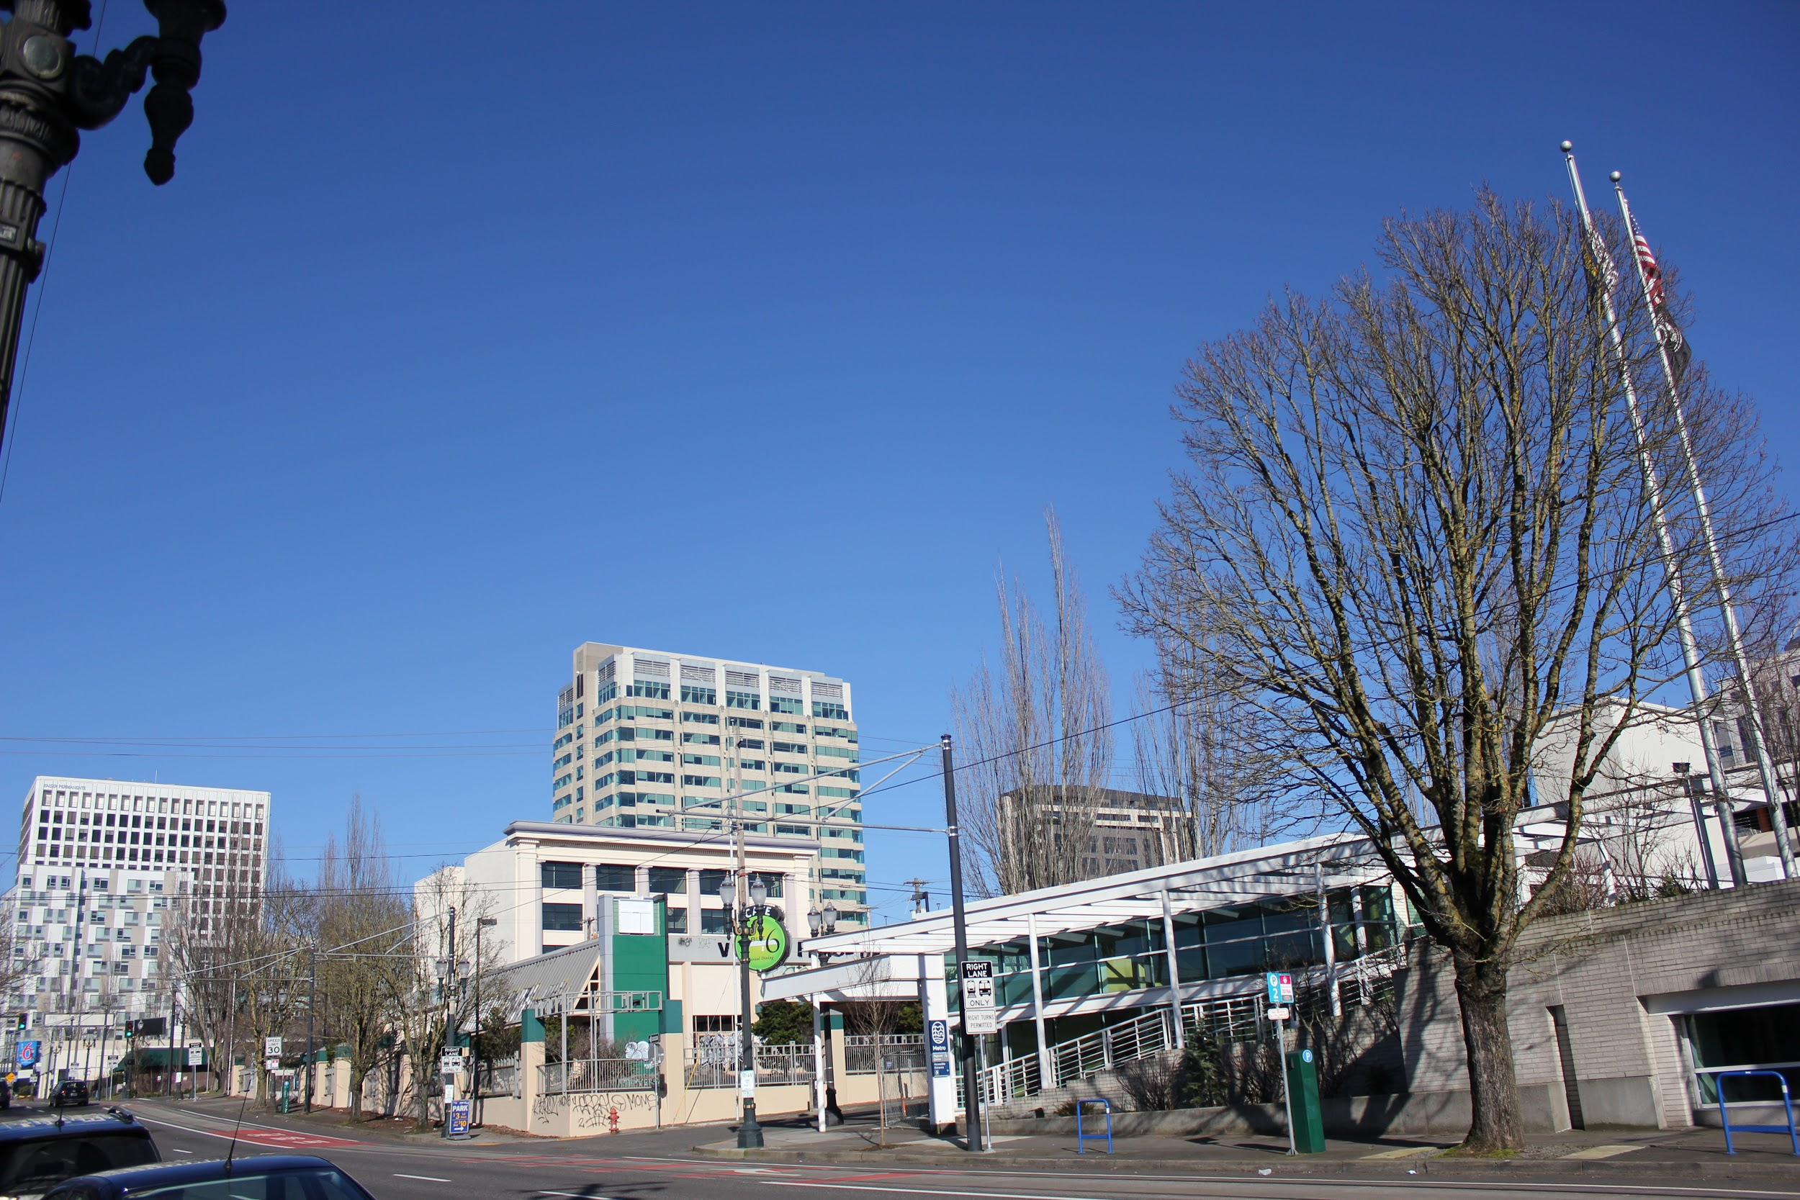
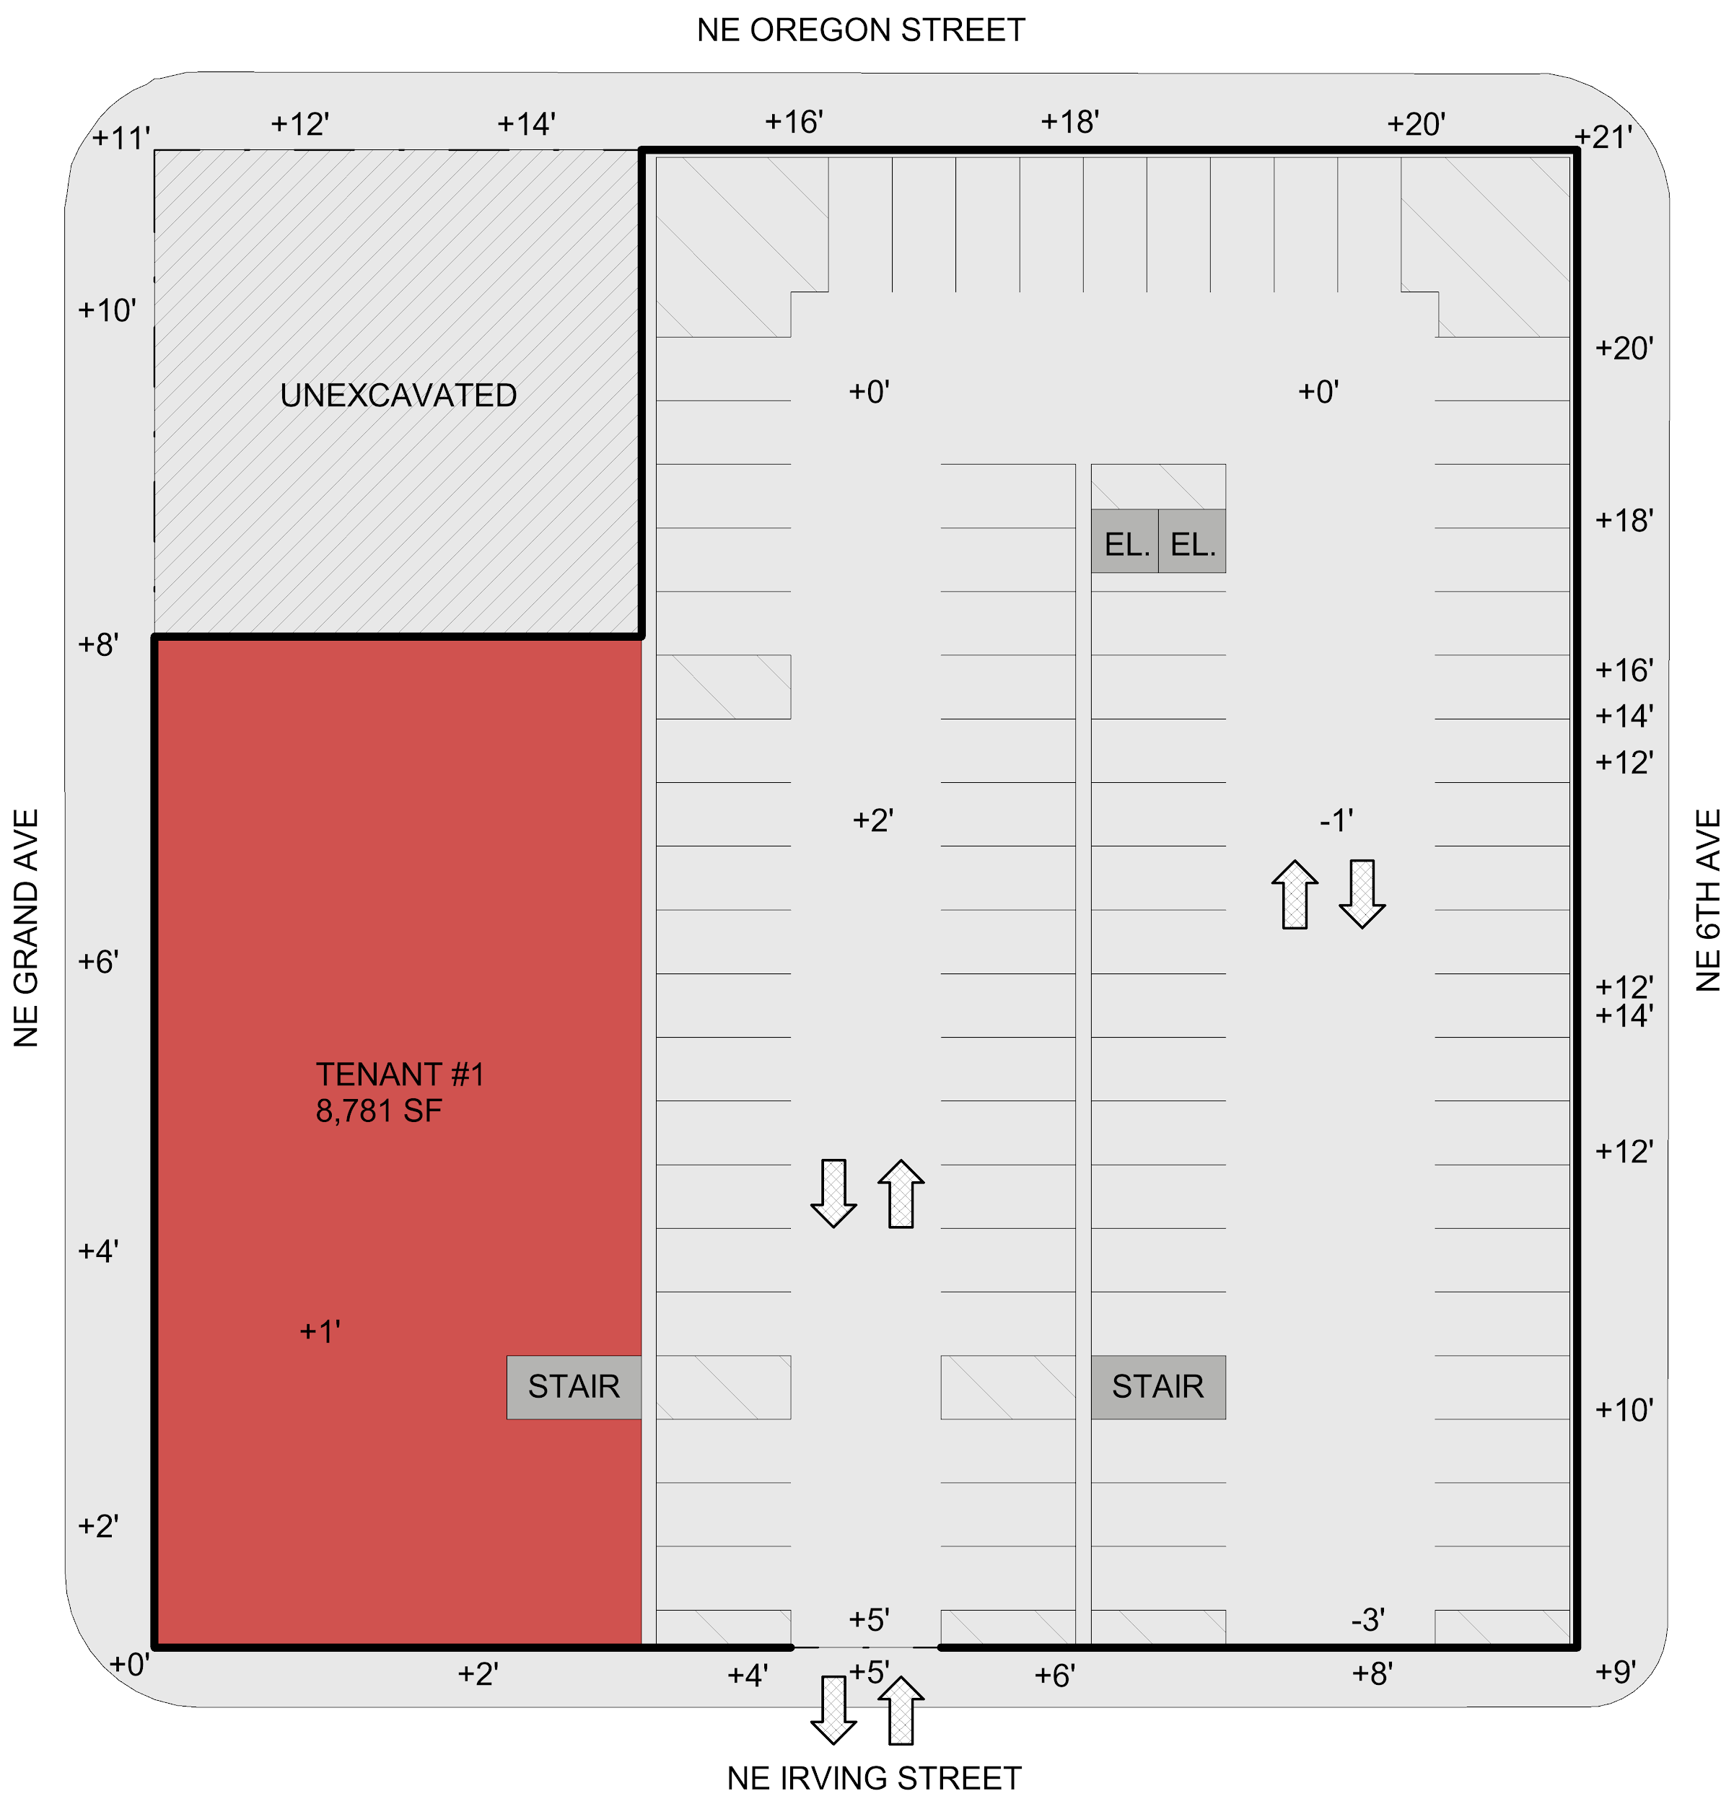
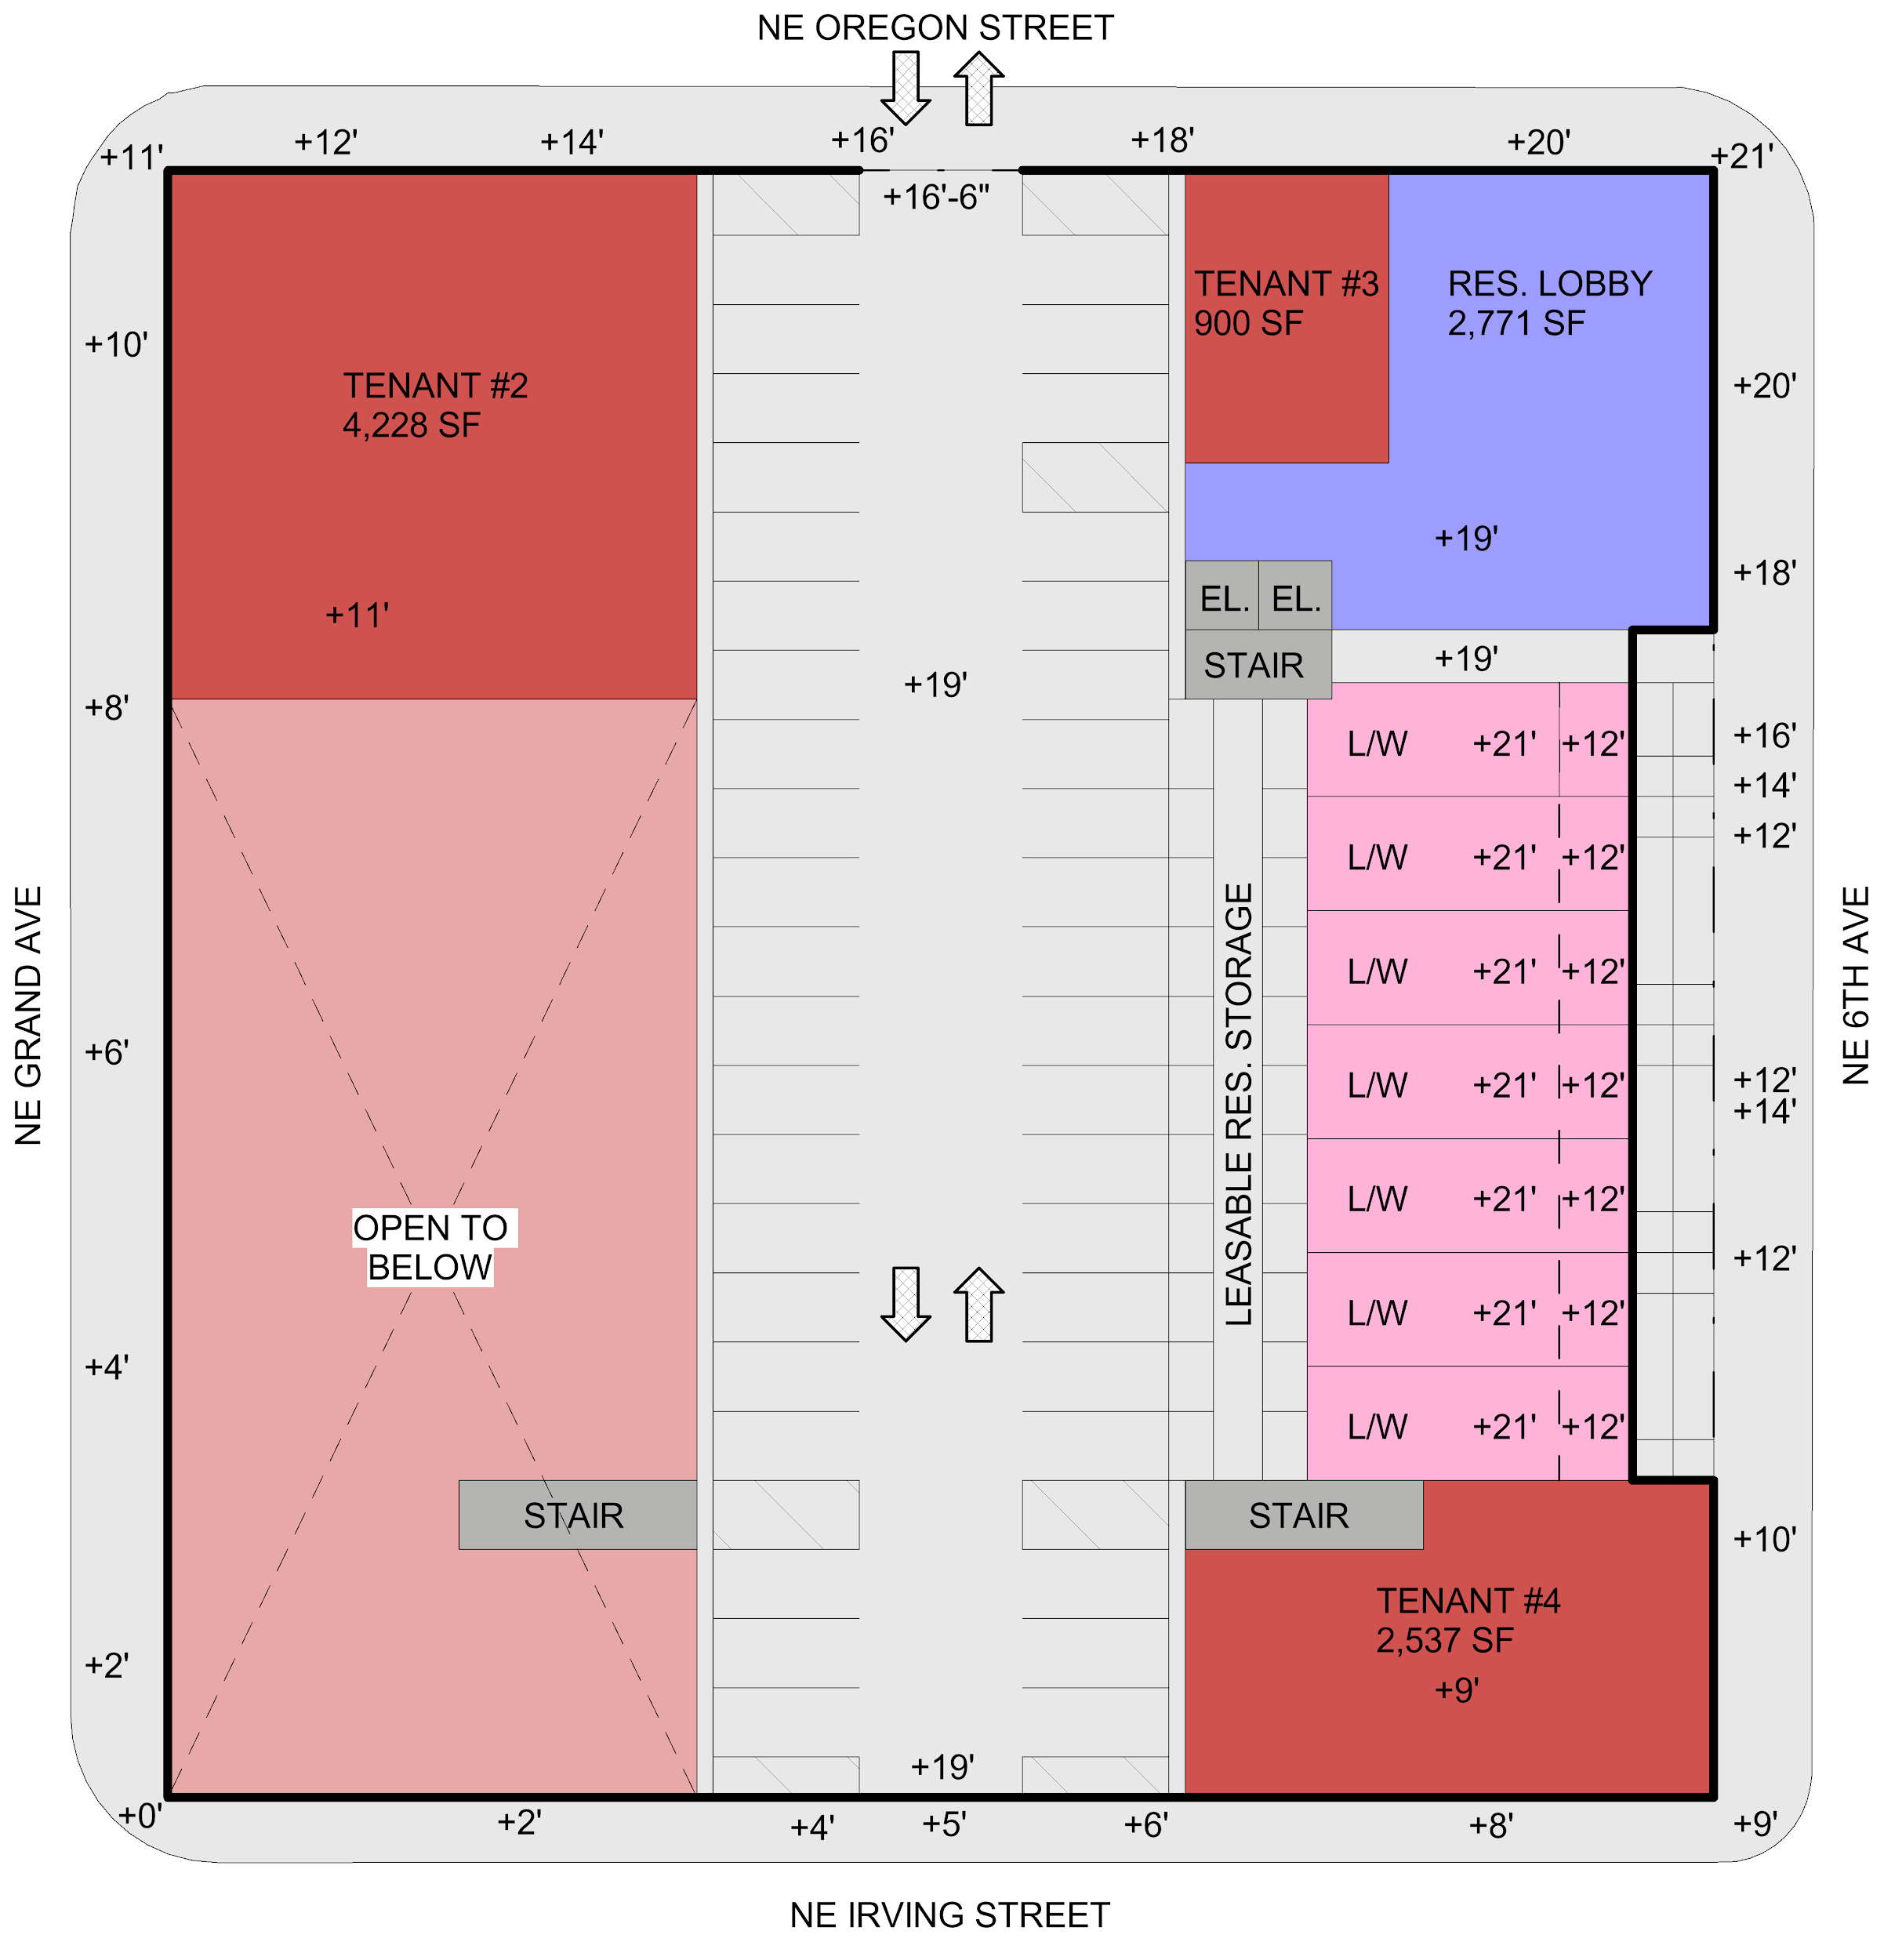
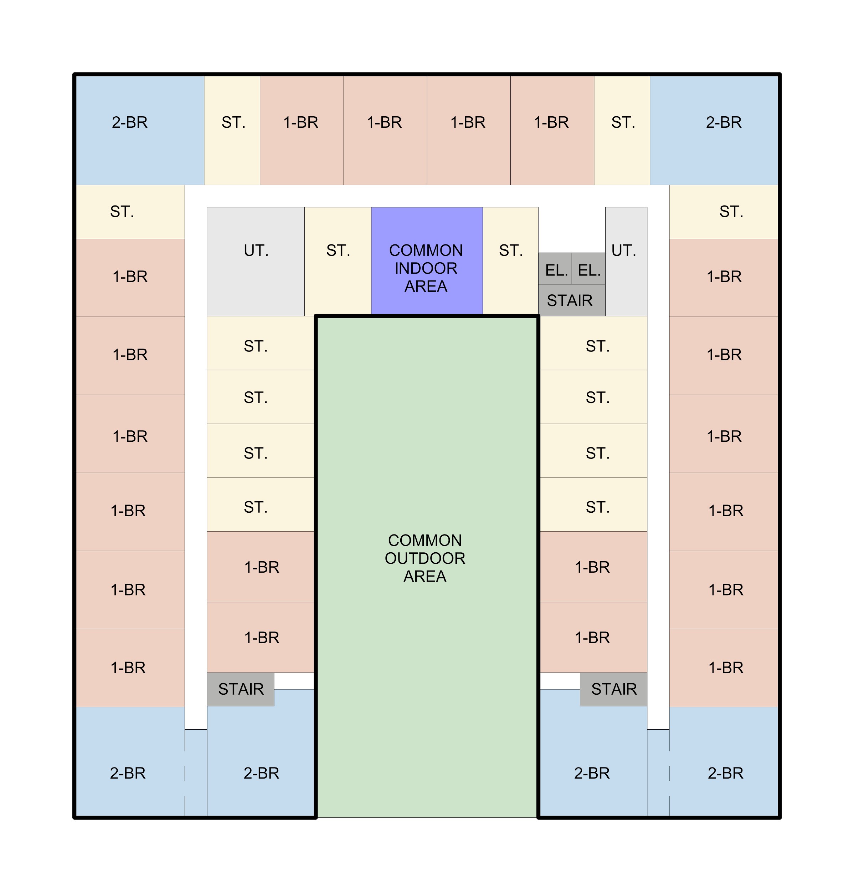
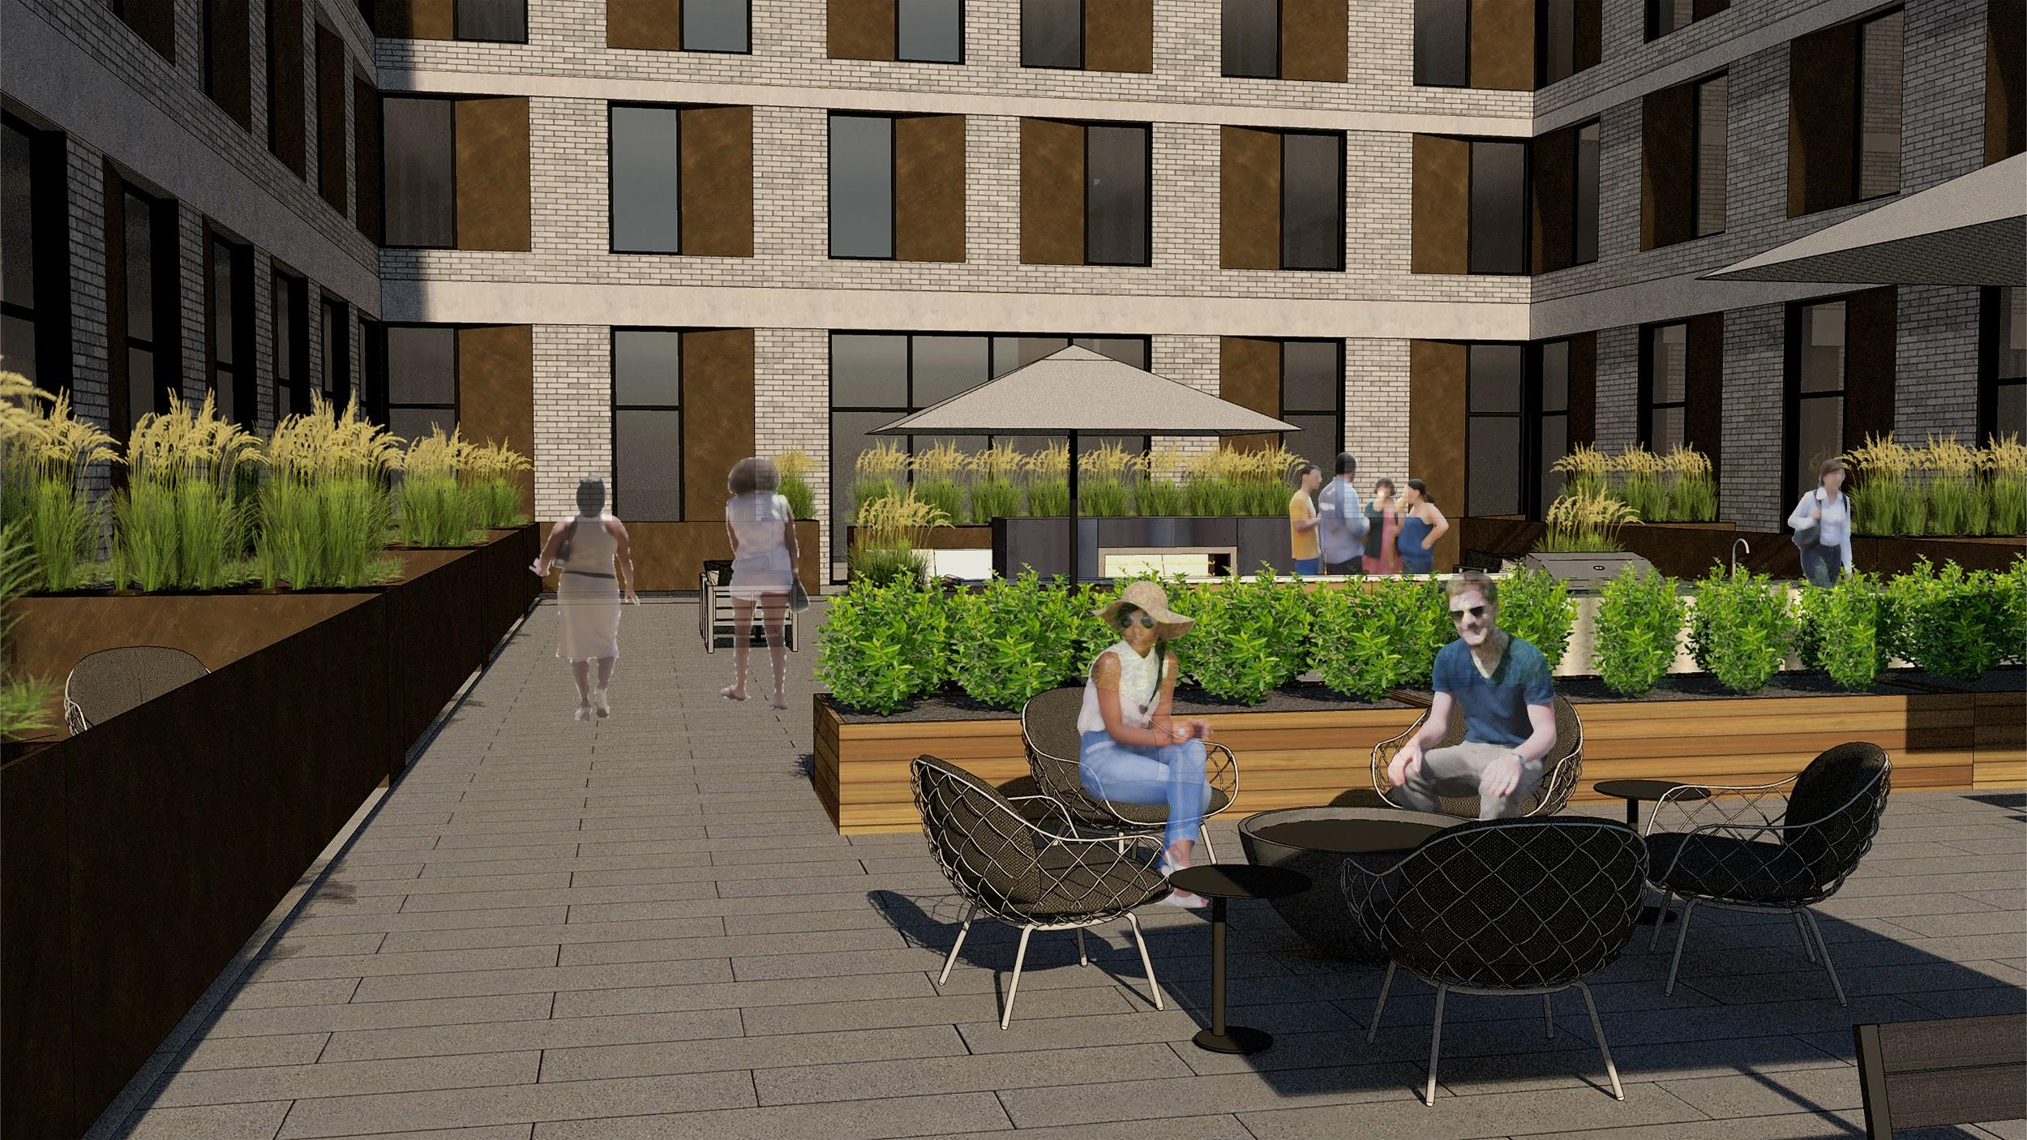
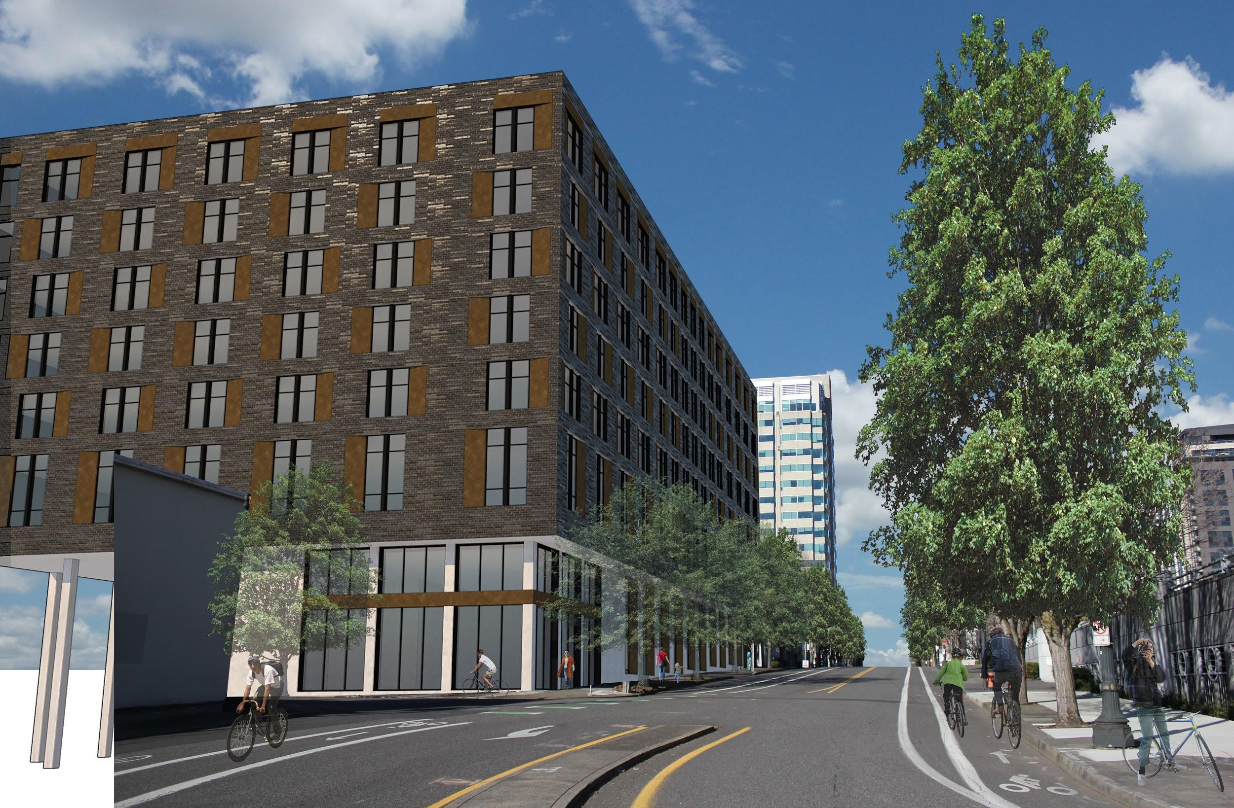
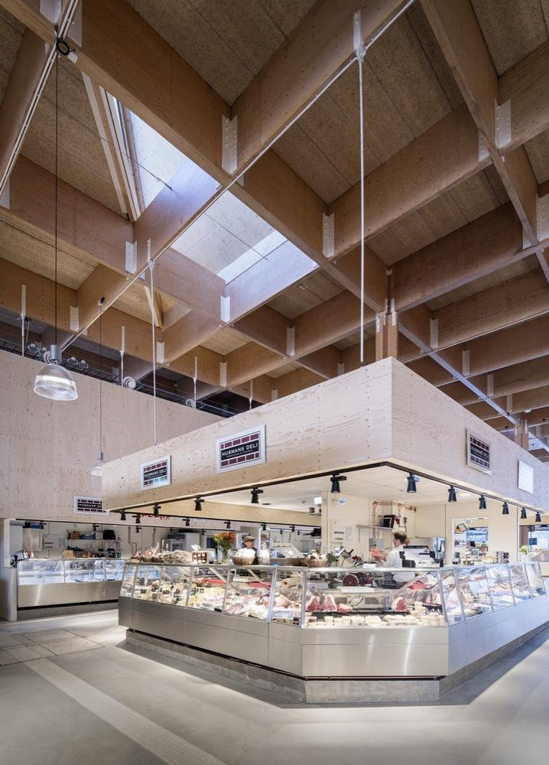
LA PLUIE MARKET RATE HOUSING
LEVEL 01 FLOOR PLAN
LEVEL 01.5 FLOOR PLAN
LEVEL 02 FLOOR PLAN
RETAIL/COMMERCIAL
RESIDENT INDOOR COMMON AREA
RESIDENT OUTDOOR COMMON SPACE
LOFTED LIVE/WORK UNIT
EXISTING BUILDING
FOOTPRINT
STUDIO UNIT
1 BEDROOM UNIT
2 BEDROOM UNIT
3 BEDROOM UNIT
Notes:
For example, on the market rate site, the existing Land Rover Building is currently sunken into the northeast section of the site and retains much of the current sounding grades. Once the existing building is demolished, with some minor additional excavation, 2/3rds of the site can have structured below grade parking at a significantly lower cost than traditional underground parking. Bracketing this parking will be the ground floor retail spaces with stepped slabs to meet grade at each street corner with the local vendor food hall taking the prime southwest corner. On the second level, residential units begin stacking and shared amenity spaces like the podium roof deck are available for resident use.

Slide 18
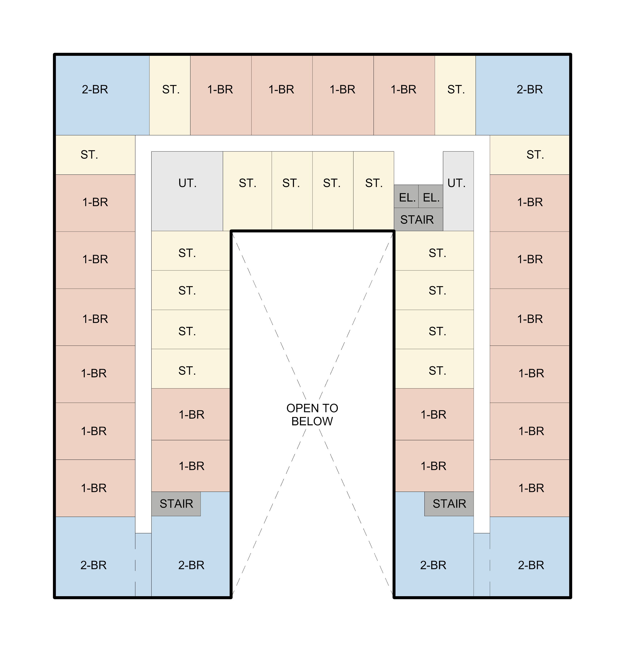
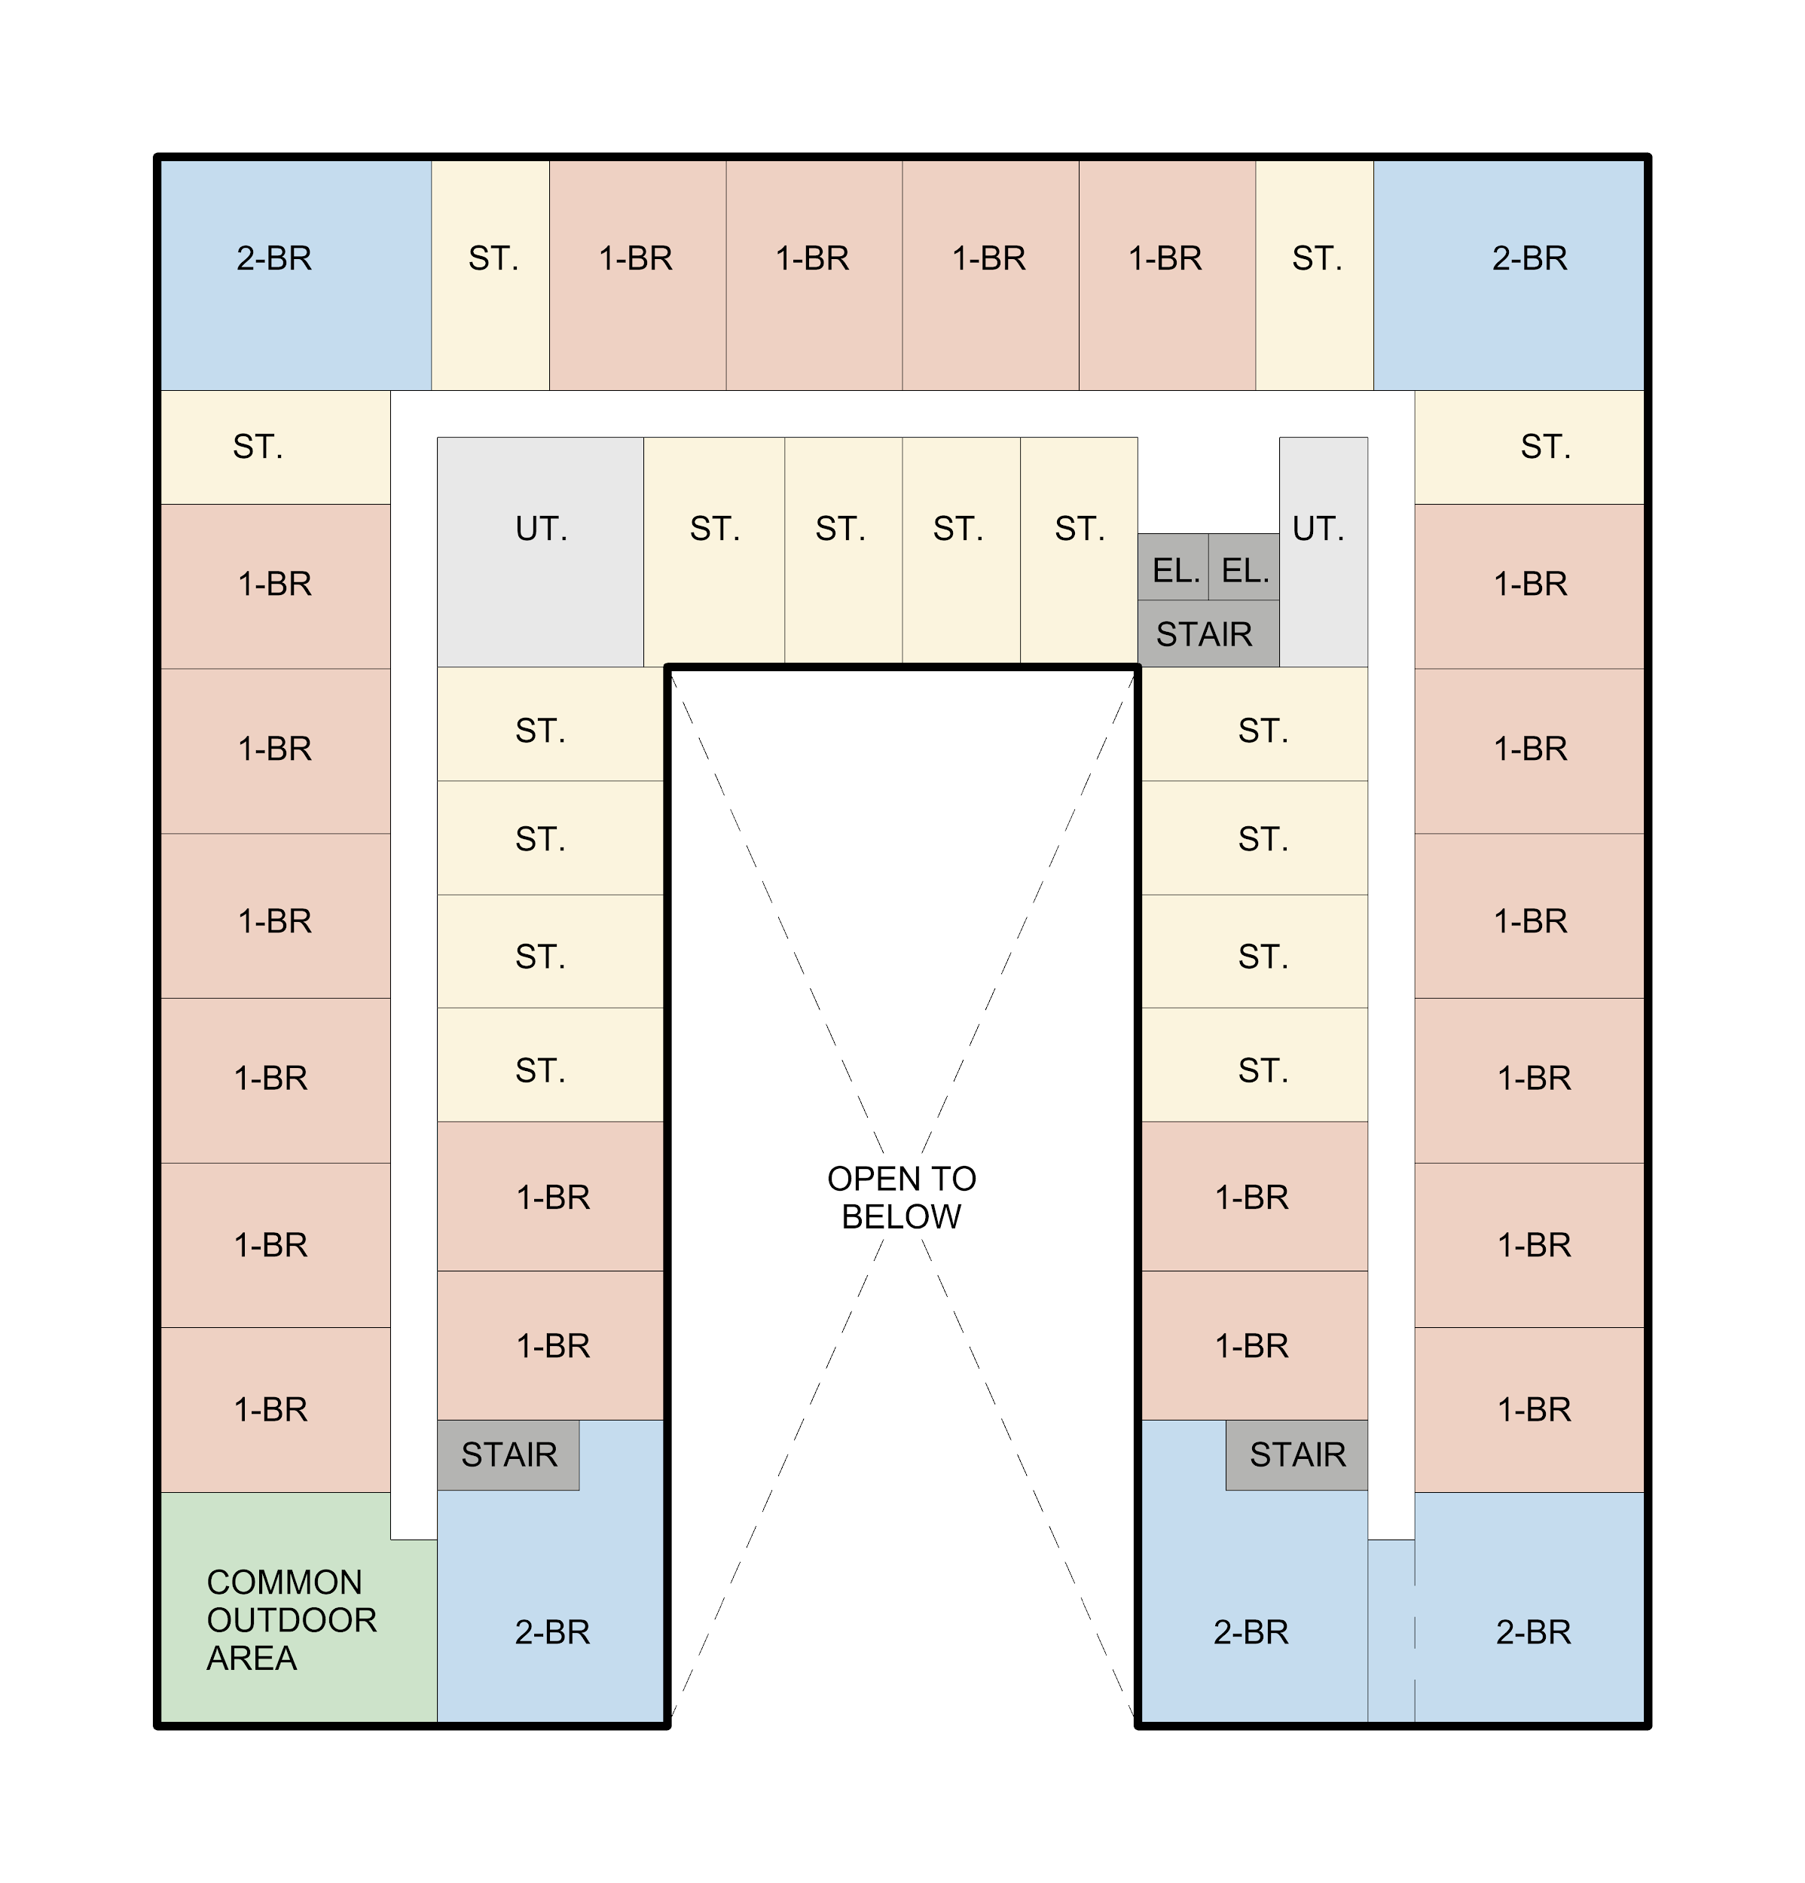
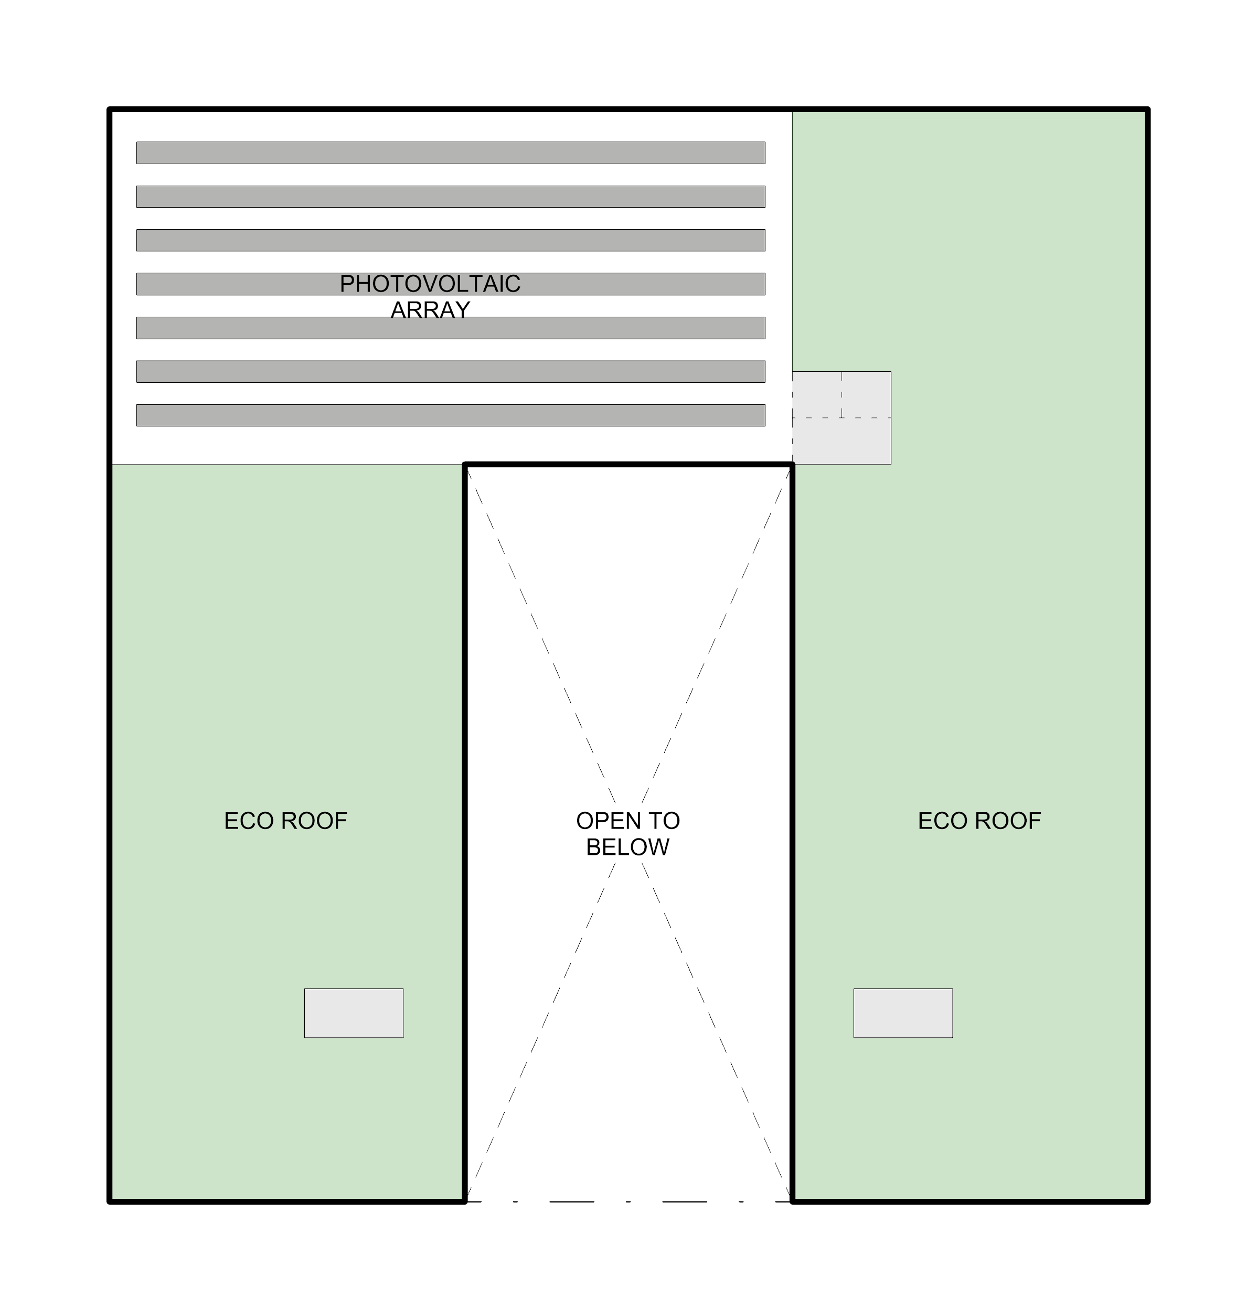
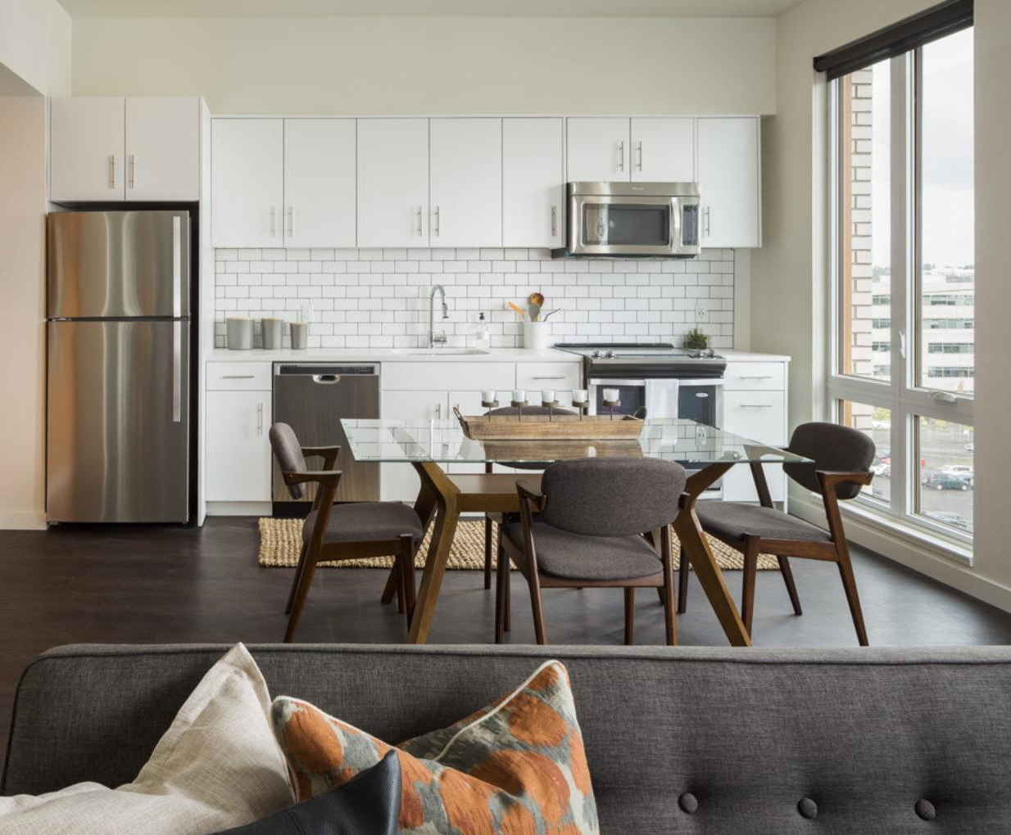
LA PLUIE MARKET RATE HOUSING
LEVEL 03-06 FLOOR PLAN
LEVEL 07 FLOOR PLAN
ROOF PLAN
RETAIL/COMMERCIAL
RESIDENT INDOOR COMMON AREA
RESIDENT OUTDOOR COMMON SPACE
LOFTED LIVE/WORK UNIT
STUDIO UNIT
1 BEDROOM UNIT
2 BEDROOM UNIT
3 BEDROOM UNIT
Notes:
Looking at the upper levels, units will have high grade finishes, and the 7th level will feature a covered amenity deck with panoramic views of downtown and the southwest hills. For the roof, the city’s ecoroof standards will apply to both the market rate and affordable projects. The proposal includes extensive planting mediums for most of the roof surface for stormwater retention with the remaining area showing a small solar array to power common areas that would otherwise be an operating expense.

Slide 19
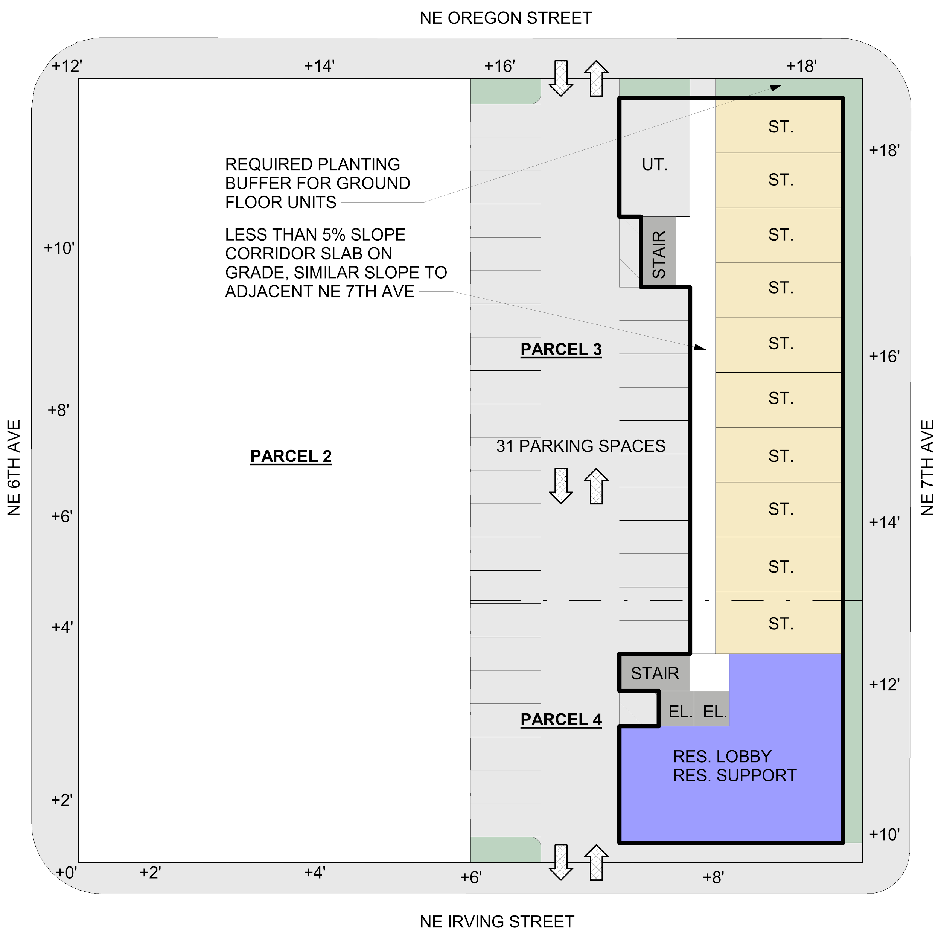
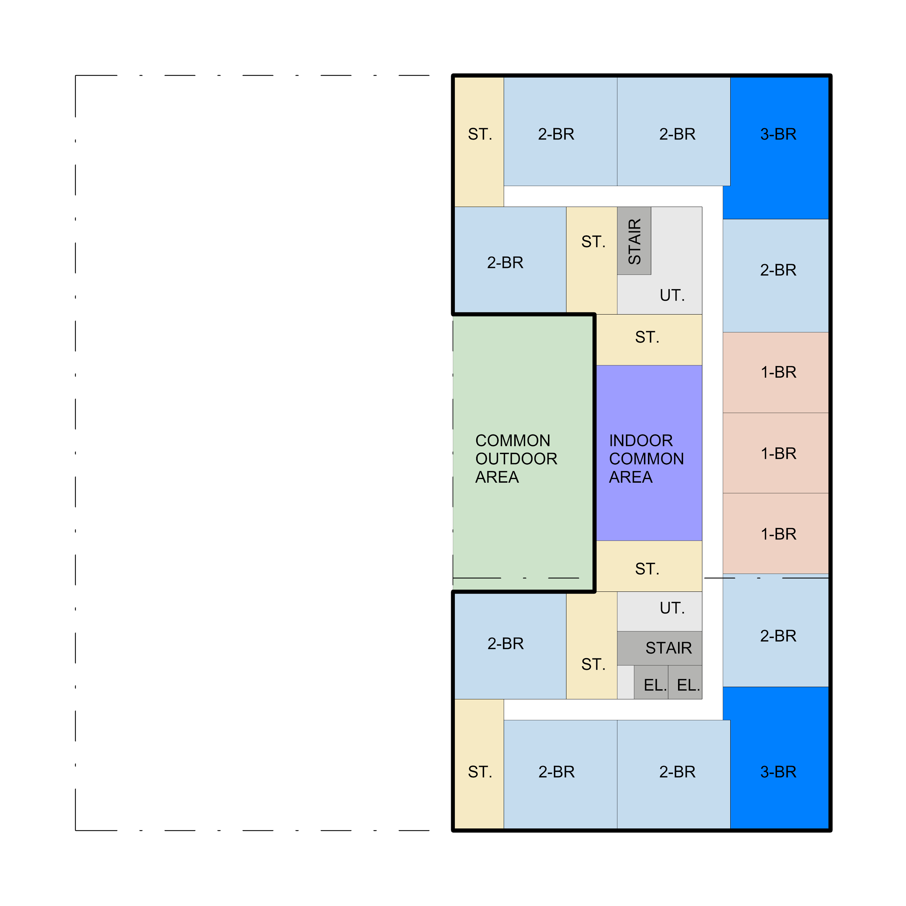
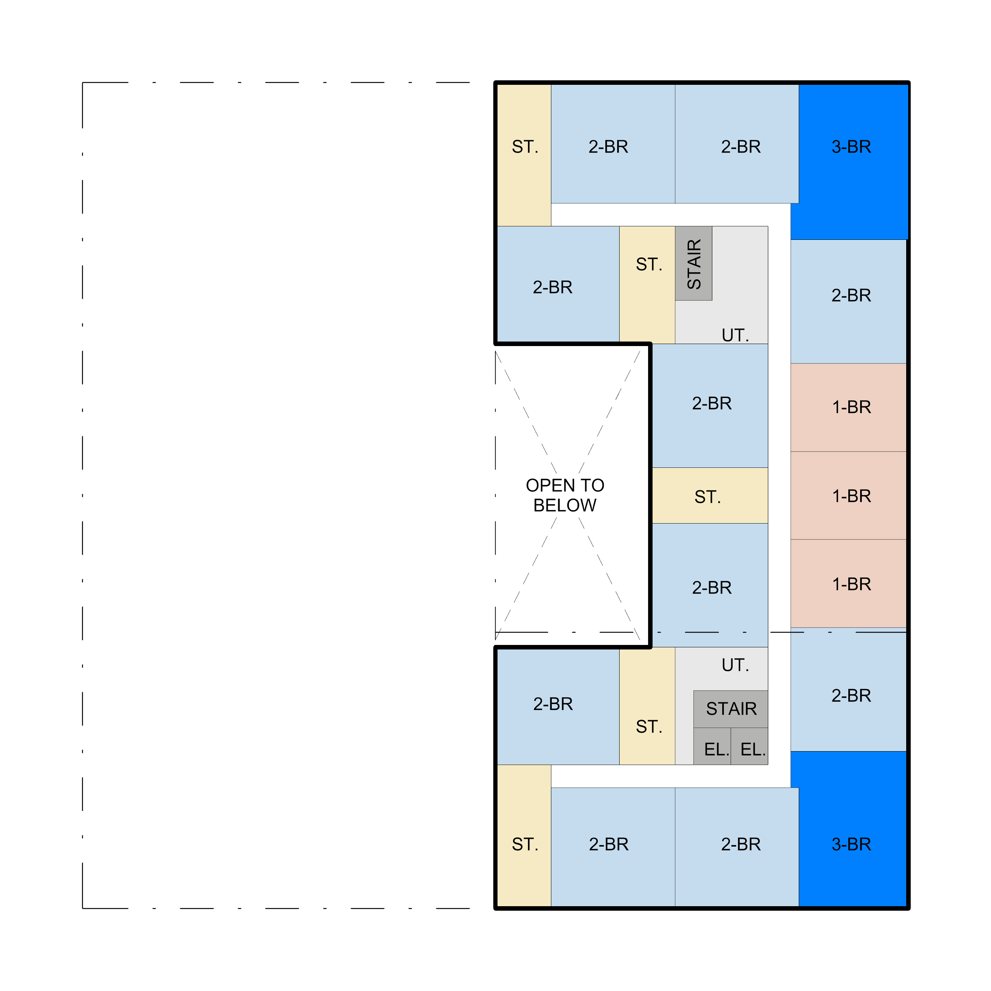
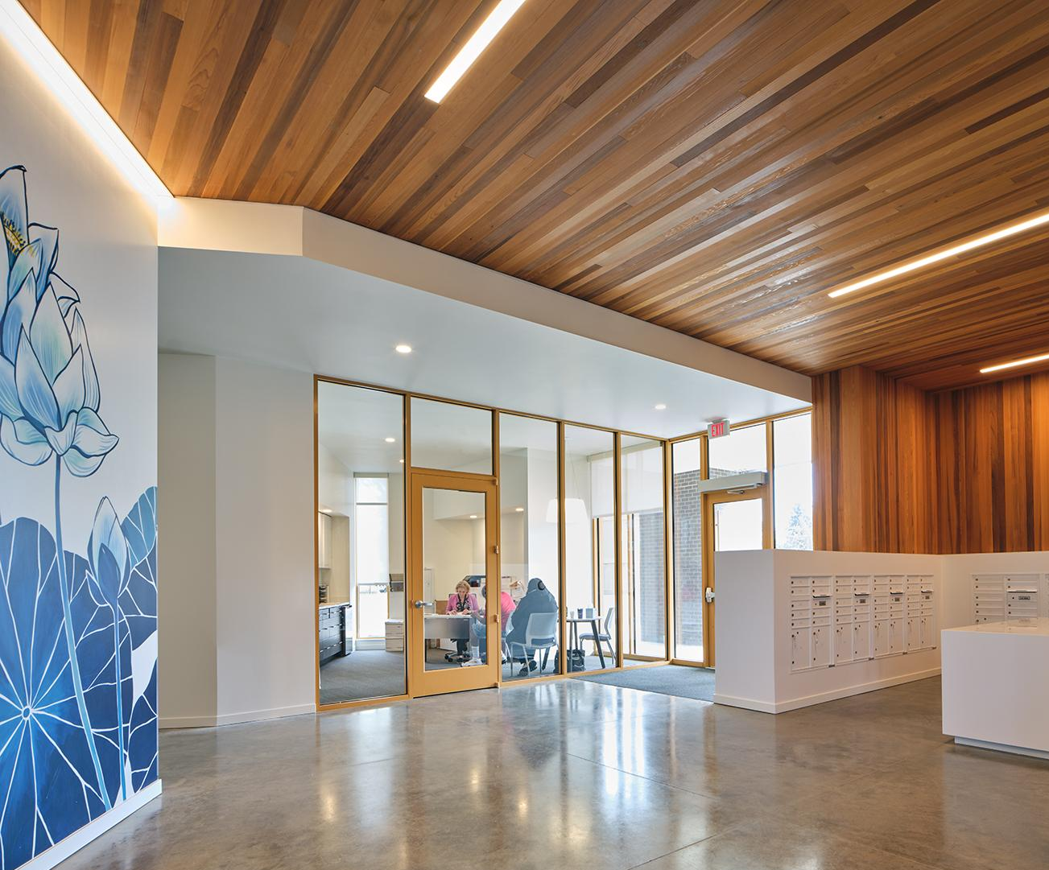
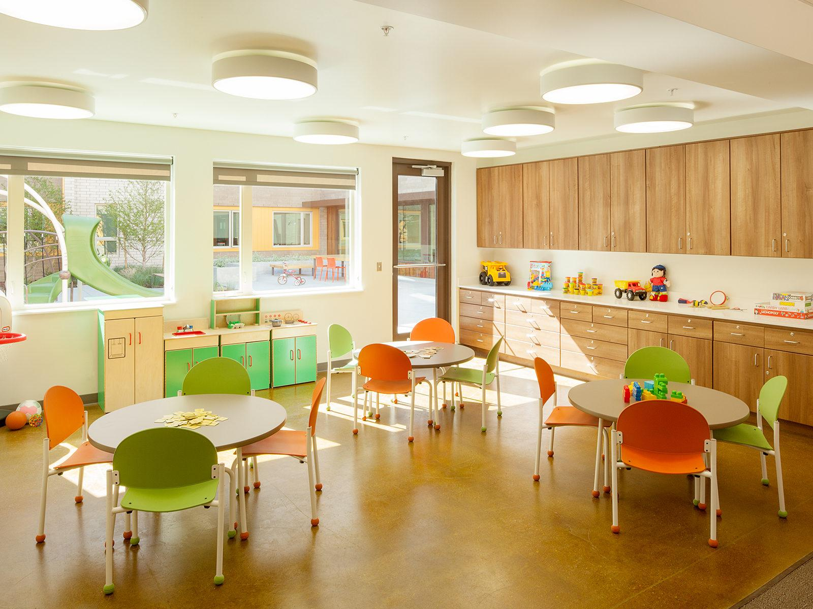
ROOTS AFFORDABLE HOUSING
LEVEL 01 FLOOR PLAN
LEVEL 02 FLOOR PLAN
LEVEL 03 FLOOR PLAN
RETAIL/COMMERCIAL
RESIDENT INDOOR COMMON AREA
RESIDENT OUTDOOR COMMON SPACE
LOFTED LIVE/WORK UNIT
STUDIO UNIT
1 BEDROOM UNIT
2 BEDROOM UNIT
3 BEDROOM UNIT
Notes:
For the affordable building plans, again moving left to right from the ground floor to typical upper floors. The ground floor will include resident services, studio units set back from the sidewalk with planting buffers, and a community room to be programmed internally and is rentable to outside groups. While not required by zoning code, surface parking will be provided for residents because family sized units will need parking.

Slide 20
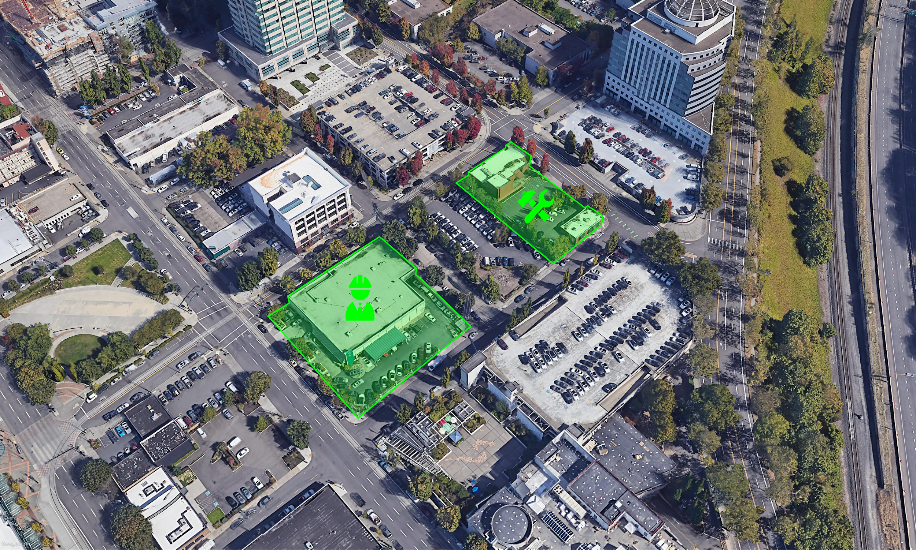
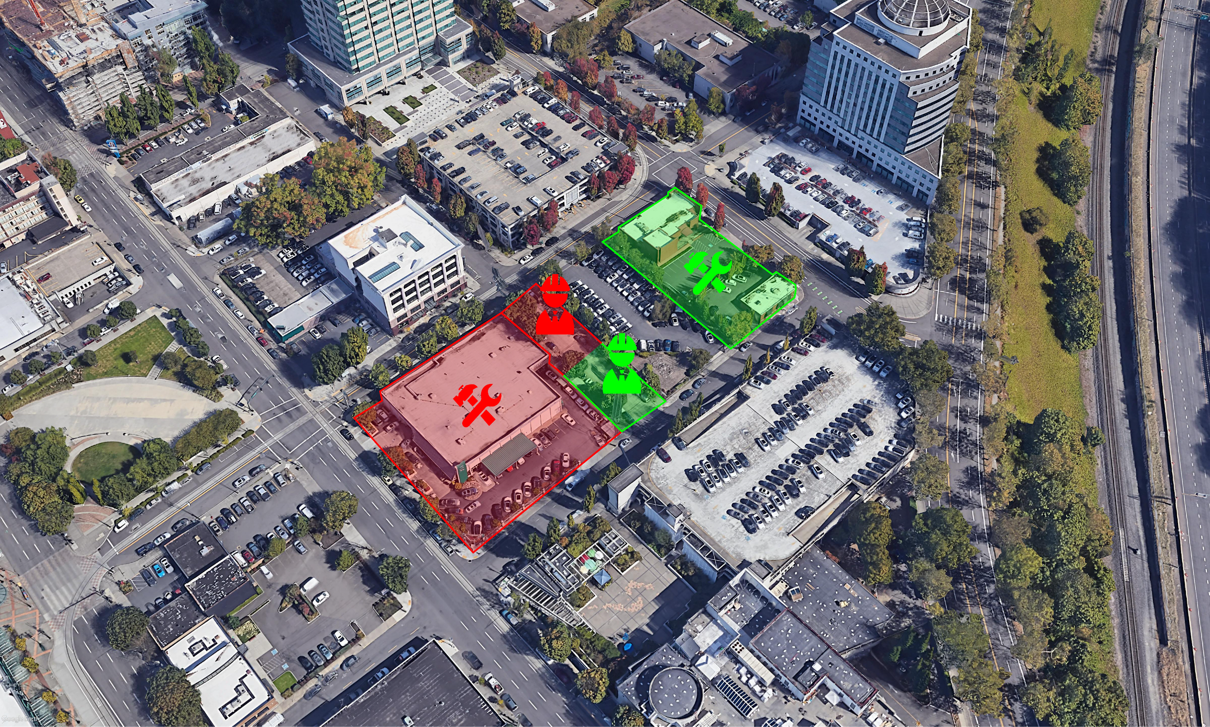
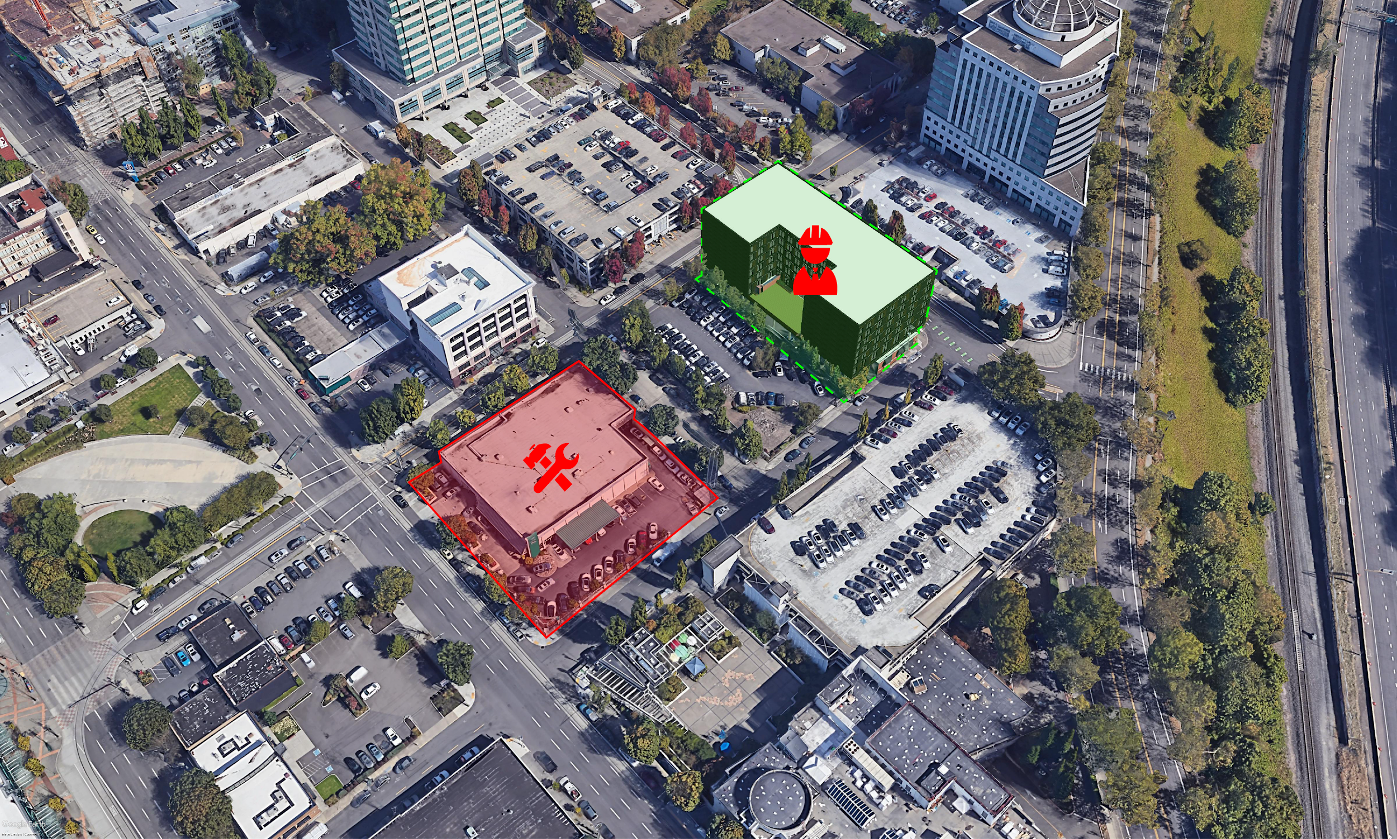
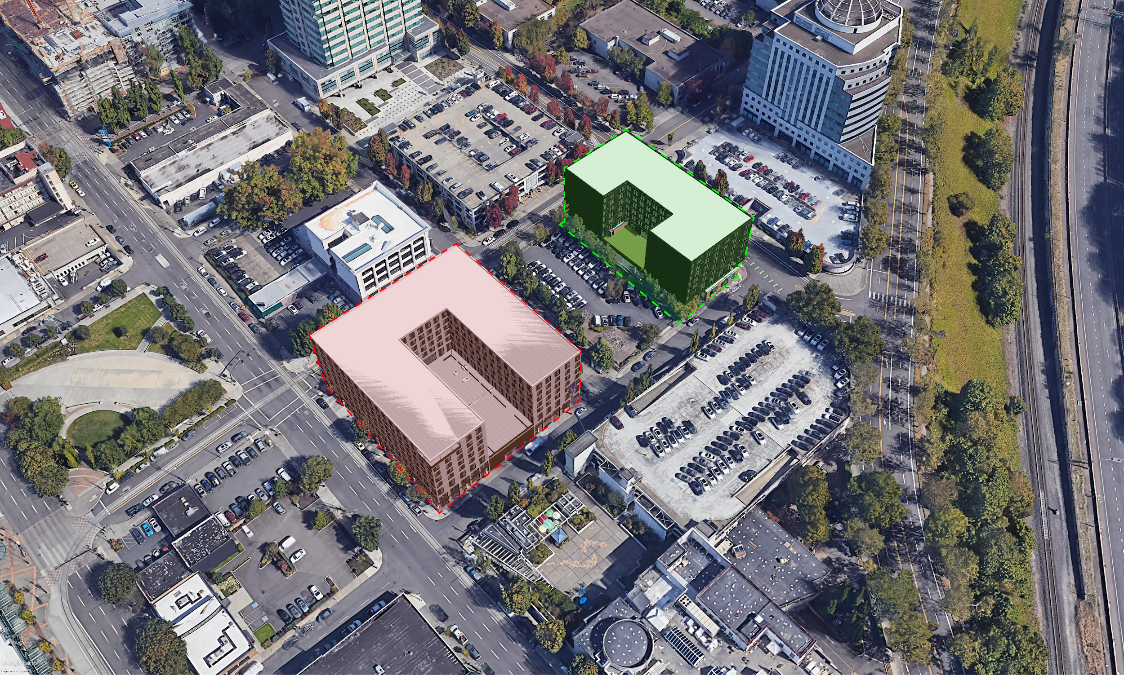
0-6 MONTHS
DEVELOPMENT TIMELINE
2021
2022
2023
2024
TASK
Q2
Q3
Q4
Q1
Q2
Q3
Q4
Q1
Q2
Q3
Q4
Q1
Q2
Q3
Q4
Q1
6-18 MONTHS
SCHEMATIC DESIGN (SD)
109 DAYS
SD PRICING
37 DAYS
DESIGN ADVICE REQUEST #1
44 DAYS
DESIGN ADVICE REQUEST #2
44 DAYS
NEIGHBORHOOD CONTACT
51 DAYS
LAND USE REVIEW TYPE III
103 DAYS
DESIGN DEVELOPMENT (DD)
109 DAYS
18-24 MONTHS
DD PRICING
37 DAYS
CONSTRUCTION DOCUMENTS
160 DAYS
BIDDING
59 DAYS
GMP/CONTRACT
59 DAYS
ROOTS PERMITTING
124 DAYS
ROOTS CONSTRUCTION
573 DAYS
ROOTS LEASE UP
ESTIMATED STABILIZATION Q2 2024
24 MONTHS
LA PLUIE PERMITTING
312 DAYS
LA PLUIE CONSTRUCTION
573 DAYS
LA PLUIE LEASE UP
ESTIMATED STABILIZATION Q4 2025
Notes:
Developing a project schedule based on these proposals, assuming we can start consultants next month, we can work through initial design phases and submit for permit on both projects early in 2022. PHB affordable housing projects can leverage Government Accountability Transparency Review (GATR) status with BDS which prioritizes their permit review above market rate housing and other project types.
Right now affordable housing projects are seeing close to 6 month permitting processes which creates a stagger in construction starts if both project proceed forward with the same design schedules. This ends up being beneficial for the overall development as existing buildings can be used for staging and contractor offices to start construction and trades can then move from the affordable project and onto the market rate project after their scope is completed. In all we’re expecting 24 months of combined construction.

Slide 21
FINANCIAL PLAN

Slide 22
FINANCIAL PLAN
MARKET RATE
LOCATION
TIMING
WHY
LA PLUIE
TRANSIT
AMENITIES

Slide 23
FINANCIAL PLAN - TIMELINE
MARKET RATE
Q4-2022
Q2-2024
Q4-2025
18 months
18 months
Closing/Construction Start
Delivery
Lease Up

Slide 24
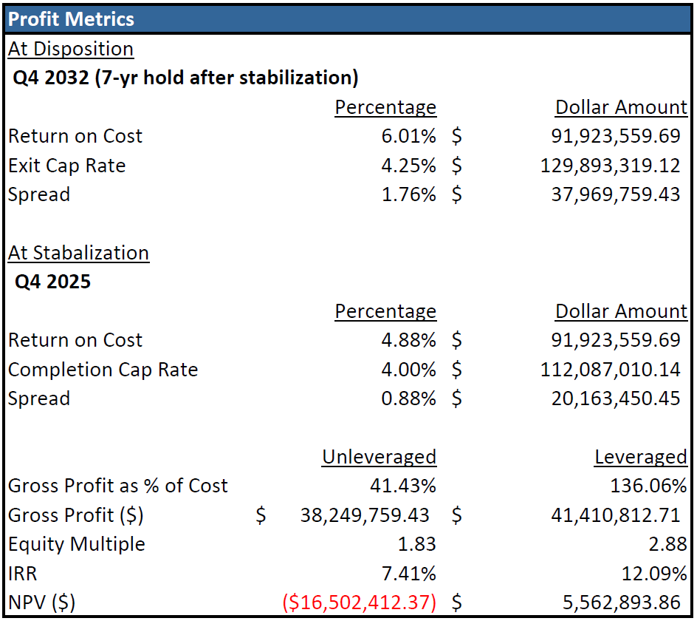
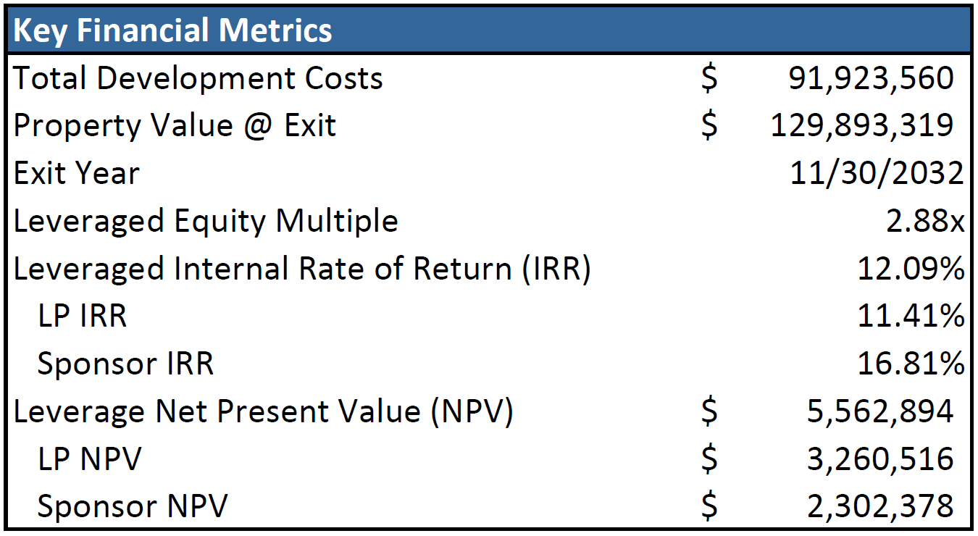
FINANCIAL PLAN
MARKET RATE

Slide 25
FINANCIAL PLAN
MARKET RATE

Slide 26
FINANCIAL PLAN
AFFORDABLE
LOCATION
OPPORTUNITY
WHY
ROOTS
DEMAND
FUNDING
Notes:
Feasible - why
Location : access to public transportation, employment center,
Demand: for affordable units, supply gap for family units, housing crisis
Funding: 4% LIHTC and Metro bond, funding flexibility
Partnership: ability to partner with a non-profit to be a GP, benefits include expertise, tax exempt status,
Opportunity for partnership, fund, for transit oriented development, reduce displacement of low income families.

Slide 27
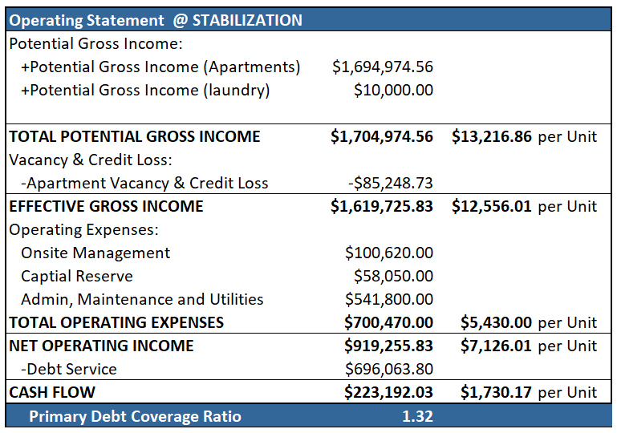
FINANCIAL PLAN - TIMELINE
AFFORDABLE
Q2-2022
Q4-2023
Q2-2024
Q3-2024
18 months
6 months
3 months
Closing/Construction Start
Delivery
Lease Up
Stabilization/Conversion
Income Assumptions | Expense Assumptions
Rents | Total OPEX - $5430 PUPY
90% @ 60% AMI | Onsite Management $780 PUPY
10% @ FMR housing 30% AMI | Capital reserve $450 PUPY
YoY increase - 2% | YoY Increase - 3%
Vacancy - 5%
Notes:
due to shorter permitting period we decided to develop Roots first. Roots Has the typical 18 mo construction period but a quicker lease up period of 6 mos with 20 units per month. As required by the bank we have a 3 months stabilization period after lease up leading up to conversion to perm loan by Q3 of 2024
Stabilized NOI assumptions

Slide 28
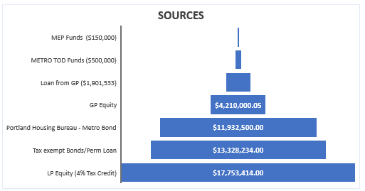
FINANCIAL PLAN - SOURCES AND USES
AFFORDABLE
Notes:
Pro-forma meets the sources requirements of OHCS, PHB
LIHTC - 4% credit; total qualified basis increased to 49k utilizing the 30% boost due to area eligibility . Assumes 0.90C to a $ for tax credit yield. Promises $19.8m tax credits over ten yr period to the investor (LP)
Total development cost = 49,973,709 = 67% hardcost and 24% development cost and 8% acquisition cost meeting LIHTC requirement
hard cost $285/unit
Leverages private funds for construction loan meeting the 50% test

Slide 29
FINANCIAL PLAN
AFFORDABLE
Notes:
Able to achieve these financial goals by
developing a proforma that meets the PHB underwriting matrix
strategically creating a co-developer partnership with a non profit organization.
That would split the developer fee
Operates and manages the affordable property during the 10 year compliance period
Utilizing the property tax abatement incentive
Utilizing available funds and incentives to develop affordable housing.

Slide 30
CONCLUSION
Notes:
While Zenith Development has many goals for La Pluie and the Root’s, some of our main goals were to find a way to provide affordable housing around accessible public transportation, provide much needed amenities, and to strengthen the immediate community that is surrounded by the Metro Planning Department building, The Hyatt Hotel at the Convention Center and Convention Center.
In the process of determining the highest and best use of our site we also considered office space and hotel, but after a thorough analysis of the office and hotel markets we concluded that with many companies going to a hybrid work setting where employees are only coming into the office part of the week or not coming in at all and Portland-area hotels not likely see a key revenue metric return to 2019 levels until the end of 2023 as consumers pay less per night and less rooms are reserved that market rate housing with retail combined with affordable housing would be the highest and best uses..
The Roots affordable housing will create a public private partnership to deliver much needed affordable units to renters in close-in Portland. The delivery of over 50% family unit will close the lack of affordable family units in the submarket as well as the general Portland Metro area.
The retail will be pivotal in determining the overall attractiveness of La Pluie to prospective tenants as an active ground-floor will be considered an amenity. Our daycare operator will provide a service for the building tenants, the surrounding residential buildings, Lloyd District workers, and Oregon Convention Center attendees. Both important and viable, the daycare will activate the space it covers on NE Grand Ave. . The lack of food options in the near vicinity to the project site combined with a dense daytime population with surrounding employers like Metro, the Oregon Convention Center, as well as improved connectivity to close-in eastside neighborhoods to the south of I-84 with the construction of Blumenauer Bridge presents a great opportunity for a food hall to thrive. The cafe will provide a highly desired service, not only for the projects’ residents but also the surrounding daytime workers and flood of Oregon Convention Center goers. The cafe will also provide the surrounding communities with a gathering place to relax and socialize.
This development project is something that will not only give extrinsic financial returns to its investors, it will also give intrinsic internal returns to its residents, Lloyd District workers, Oregon Convention Center attendees, as well as the eastside neighborhoods to the south of I-84 that will be connected with the construction of Blumenauer Bridge.

