Slide 1
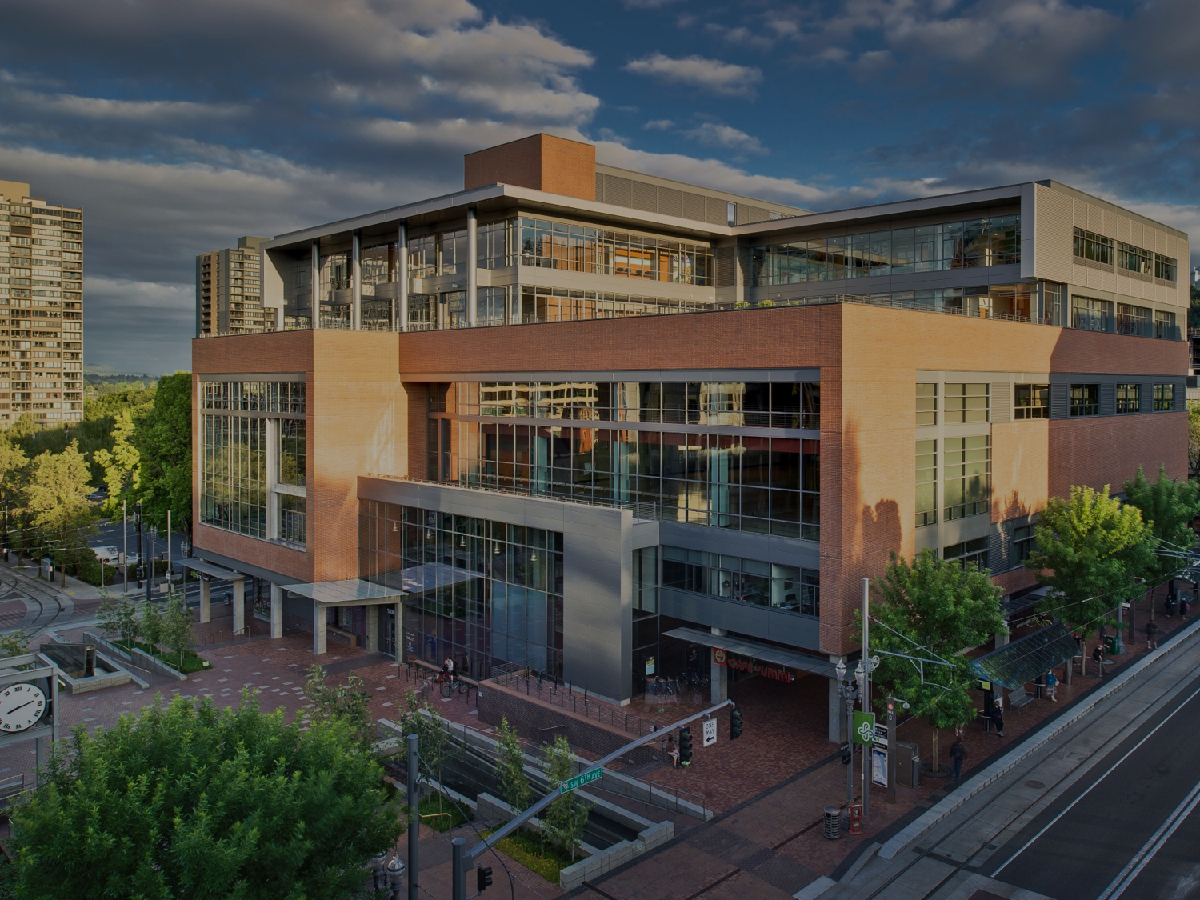

WELCOME TO THE COMPUTER SCIENCE DEPARTMENT
ADVICE AND ANSWERS FOR POST-BACCALAUREATE STUDENTS

Slide 2
AGENDA
  As a Post-bac, you have options!
  Bachelors or Masters…what’s the difference?
  Master’s Degree Requirements
  Bachelor’s Degree Requirements
  Planning your Post-bac program of study
  Prior Credits and Experience
  Q&A

Slide 3
BACHELOR’S OR MASTER’S?
Bachelor’s degree
May be quicker
Broad Study
Average starting salary: $60K
Master’s degree
May be quicker
Area of Focus
Average starting salary: $80K

Slide 4
MASTER’S DEGREE IN
COMPUTER SCIENCE (45 CREDITS)
Core (6 credits)
Programming Core
Theory Core
Track (9 credits)
Databases
Artificial Intelligence & Machine Learning
Languages
Security
Software Engineering
Systems
Electives (30 credits)
Additional 500-level CS courses
15 credits can be outside of CS

Slide 5
BACHELOR’S DEGREE IN COMPUTER SCIENCE (122 CREDITS*)
Programming & Theory Core (50 Credits)
Upper Division Electives (24 Credits)
Senior Capstone (6 Credits)
Non-CS Major Requirements (40 Credits)
*May vary based on prior experience

Slide 6
PATH #1:
SECOND BACHELOR’S DEGREE IN CS
Broader topical coverage than Master’s program
Begin any term
Must complete all undergraduate major requirements; CS credits and additional courses (Math, Science, etc.)

Slide 7
PATH #2:
TRADITIONAL GRAD PREP TO MASTERS
Begin any term
Must maintain a B or better
Completed in as little as 15 months plus required time for Master’s program
Must complete (or demonstrate mastery) of most undergraduate computer science coursework.
  Consists of Programming, Languages, and Theory
  32-40 credits (Depending on your starting point)

Slide 8
WHERE DO I BEGIN?
We have multiple entry points to begin your studies
1. No prior programming and limited math?
  Start with CS 199
2. No prior programming and some math?
  Start with CS 161
3. Some programming experience?
  Start with CS 162
How should I know if I am ready for CS 162?
  There is an expected prep guide available on our website to help you determine if you should begin CS 162

Slide 9
PORTLAND COMMUNITY COLLEGE
You may begin your Post-bac study at a community college, such as PCC.
Most lower division courses for the Grad Prep and second Bachelor’s (including non-CS major requirements) can be completed at PCC.
  PLEASE NOTE: PCC requires you to start with CS 140U and CS 161 and requires MTH 251 & CS 162 for CS 250
  Beginning Winter 2021, Grad Prep students must take CS 202 at PSU
Contact PCC’s CS Advisor: Michele Maxwell (Michele.Maxwell@pcc.edu)
  Include PCC ID and undergraduate transcripts (unofficial OK)

Slide 10
SCHEDULING IS IMPORTANT
We enforce prerequisites! Consider this when planning your program of study
Departmental Admissions is required in order to complete upper division CS courses
Planning to do the master’s? You must have all grad prep courses completed before you start.

Slide 11
PRIOR CREDITS AND EXPERIENCE
Determine if your prior courses match our requirements.
  https://transferology.com/school/pdx
  Request transfer evaluation upon Post-bac admission
  Additional evaluation through course’s department may be required

Slide 12
WHAT ARE MY NEXT STEPS?
Apply to PSU for Post Bac admission.
Determine which CS course you want to begin with.
Schedule an appointment with an adviser.

Slide 13
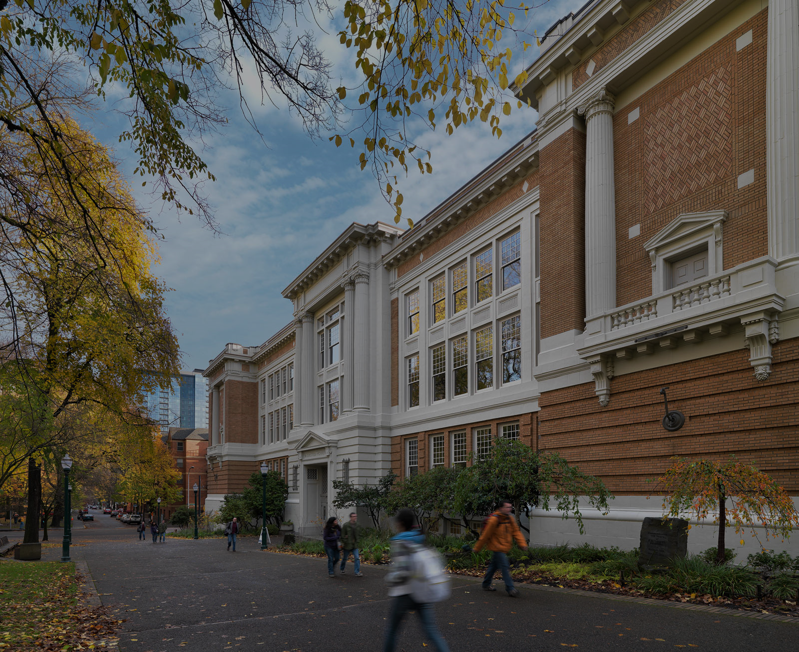
THANK YOU!

